Slide 1


Raising Awareness of Domestic Abuse
Course Aims and Objectives
Aims:
To develop a greater understanding of what Domestic Abuse is, who it affects, as well as its impact on individuals, children, the wider family, and the community.
Outcomes:
On completion of this course, participants will be able to:
Identify the different types of domestic abuse, and how wide-spread it is
Recognise the signs of domestic abuse
Explore some of the myths, barriers, stereotypes, and impacts of domestic abuse; in particular how these relate to Christian faith and Church communities
Evaluate the needs of domestic abuse survivors in order to support them effectively, while at the same time understanding the boundaries and limitations of your own role
Orientation

Slide 2
Raising Awareness of Domestic Abuse
Course Overview
1
Power and abuse in family relationships
2
The dynamics of domestic abuse
3
So-called ‘honour-based’ abuse
4
Domestic abuse and the church
5
Safeguarding responsibilities
Orientation

Slide 3


Raising Awareness of Domestic Abuse
Advance Warning and Guidance
While you’re taking this course, you might feel upset or distressed - or you may find that you are personally affected by the issues raised.
Take a break and return when you are ready
Seek support from someone you trust, if you need to
This course may generate concerns about someone you know.
Contact a safeguarding officer or equivalent in your setting.
Dial 999 and ask for the police if there is immediate danger.
If there are children involved, treat as a child safeguarding response.
The LADO should be contacted if your concerns are about someone who works with a vulnerable group.
Orientation

Slide 4

Raising Awareness of Domestic Abuse
Definition of Domestic Abuse
Domestic abuse is…
"any incident or pattern of incidents of controlling, coercive, threatening behaviour, violence or abuse between those aged 16 or over who are, or have been, intimate partners or family members regardless of gender or sexuality. The abuse can encompass, but is not limited to, psychological, physical, sexual, financial or emotional abuse"
UK Government
It includes…
Any type of romantic/sexual/marital relationship where one party is abused by the other.
Where a child over the age of 16 is subjecting any other family member over the age of 16 to abuse.
So called ‘honour based' violence, female genital mutilation (FGM), and forced marriage.
What we know…
Domestic abuse is widespread and not determined by gender, ethnicity or religion.
Victims of domestic abuse are more likely to be those who have relatively less power.
Social norms are a significant factor in legitimising and sustaining the actions of perpetrators.
Part 1: What is domestic abuse?

Slide 5
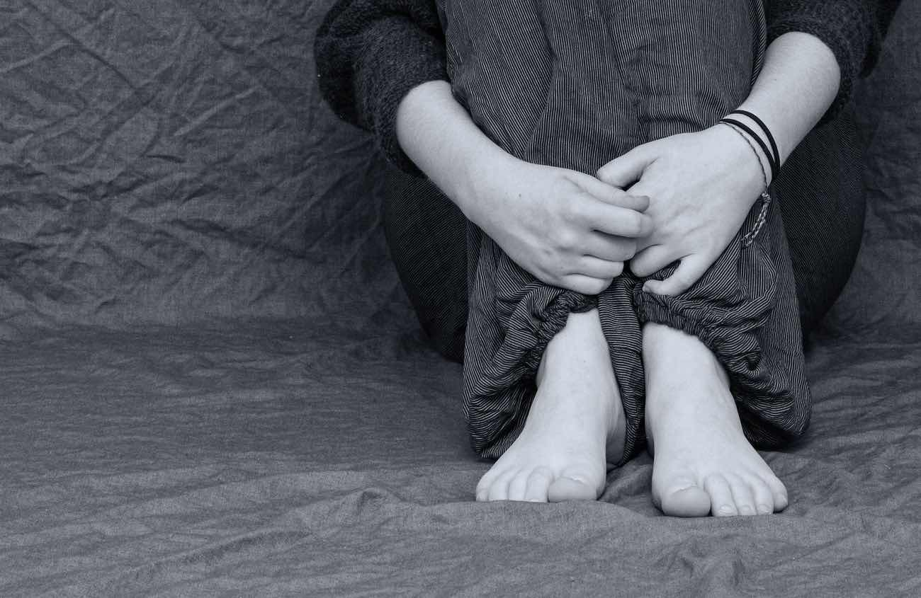
Raising Awareness of Domestic Abuse
Coercion and Control
Controlling behaviour
“a range of acts designed to make a person subordinate and/or dependent by isolating them from sources of support, exploiting their resources and capacities for personal gain, depriving them of the means needed for independence, resistance and escape, and regulating their daily life;"
Serious Crime Act 2015
Coercive behaviour
“Coercive behaviour is defined as an act or a pattern of acts of assault, threats, humiliation and intimidation, or other abuse, that is used to harm, punish, or frighten their victim."
Serious Crime Act 2015
‘Coercive control’ may involve:
Taking control over someone’s everyday life.
Monitoring or controlling someone’s emails, text messages, or social media accounts.
Threats to kill or harm
Harassment and stalking
Part 1: What is domestic abuse?

Slide 6
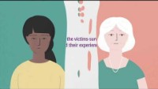
Raising Awareness of Domestic Abuse
Hidden in Plain Sight (video)
Hidden in plain sight

Slide 7


Raising Awareness of Domestic Abuse
Statistically Speaking
Going beyond our preconceptions
The majority of domestic abuse occurs within heterosexual relationships.
Women are more likely to be survivors of domestic abuse.
Men can be victims too.
Violence and abuse also occurs within LGBTQI+ relationships.
The latest estimates:
1 in 3 women will experience domestic violence in their lifetimes.
1 in 6 men will experience domestic abuse in their lifetime.
2 women are killed every week by current or former partners, in contrast to 30 men per year.
(Crime Survey, England and Wales 2019 & Office for National Statistics, 2019)
Part 1: What is domestic abuse?

Slide 8



Raising Awareness of Domestic Abuse
‘Toxic Masculinity’
What is ‘toxic masculinity’?
A concept of masculinity also places significant importance on ‘manliness’ based on:
      strength
      lack of emotion
      self-sufficiency
      dominance
      sexual virility
    According to traditional ‘toxic masculine’ values, a man who does not display enough of these traits may fall short of being a ‘real man.’
    These ideals are often found in popular culture.
What’s the problem?
Over-emphasising these traits may lead to harmful imbalances in a person who is trying to live up to these expectations. Some examples include:
aggression
sexual aggression or control
showing no emotion or suppressing emotions
hyper-competitiveness
needing to dominate or control others
a tendency towards or glorification of violence
isolation
low empathy
entitlement
chauvinism and sexism
Part 1: What is domestic abuse?

Slide 9
Raising Awareness of Domestic Abuse
Review Your Learning: Part 1 (question 1 of 3)
So far in this course, we have learned some key ideas and realities relating to domestic abuse.
Choose 3 true statements from the options below:
                Domestic abuse can sometimes be directed from children and young people towards their parents, carers or guardians.
                Domestic abuse includes any situation that involves so called 'honour' based violence, female genital mutilation (FGM) and forced marriage.
                Domestic abuse is exclusively perpetrated by men.
                'Controlling behaviour' is defined as a range of acts designed to make a person subordinate and/or dependent.
Review Your Learning: Part 1 (question 1 of 3)
Notes:
Answer: 1,2,4

Slide 10
Raising Awareness of Domestic Abuse
Review Your Learning: Part 1 (question 2 of 3)
We have learned so far in this course that the majority of domestic abuse between partners is perpetrated by men against women.
Which two of the following statements might be possible explanations for this?
                Men are more likely to feel inadequate, insecure or entitled in relationships due to cultural ideals about the nature and roles of men and women.
                Men do not report domestic abuse against themselves as readily as women.
                In general, men have a greater degree of power (eg .economically, physically) than women, and therefore may be in a position to use that power wrongly.
                Domestic abuse does not occur within LGBTQI+ relationships.
Review Your Learning: Part 1 (question 2 of 3)
Notes:
Answer: 1,3

Slide 11
Raising Awareness of Domestic Abuse
Review Your Learning: Part 1 (question 3 of 3)
What is the relevance of the term 'toxic masculinity' to the subject of domestic abuse?
Choose two from the list below
                'Toxic masculinity' is an irrelevant concept when it comes to domestic abuse.
                'Toxic masculinity' refers to certain ideas about what it means to be male.
                In an attempt to live up to a set of ideals about masculinity, some men act in harmful ways toward others.
Review Your Learning: Part 1 (question 3 of 3)
Notes:
Answer: 2,3

Slide 12


Raising Awareness of Domestic Abuse
Abuse and the Misuse of Power
Power and social norms
Power arises from various sources - age, gender, position, wealth etc.
Social norms and beliefs can reinforce or legitimise the use of power.
Our ‘false narratives’ or ‘basic assumptions’ often govern our behaviour towards others.
e.g. women's role in leadership or the home
Resistance or perceived failure
Can be met with force (emotional, psychological or physical) in order to gain compliance.
Compliance always serves to reinforce the position of the abuser.
These dynamics are common in society, and are often found in families, community and the church.
Part 2: The dynamics of domestic abuse

Slide 13
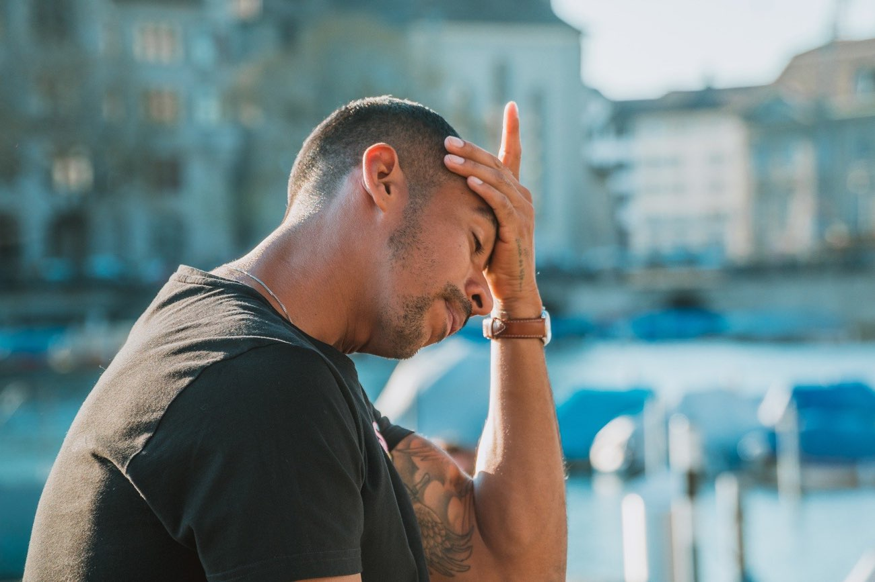
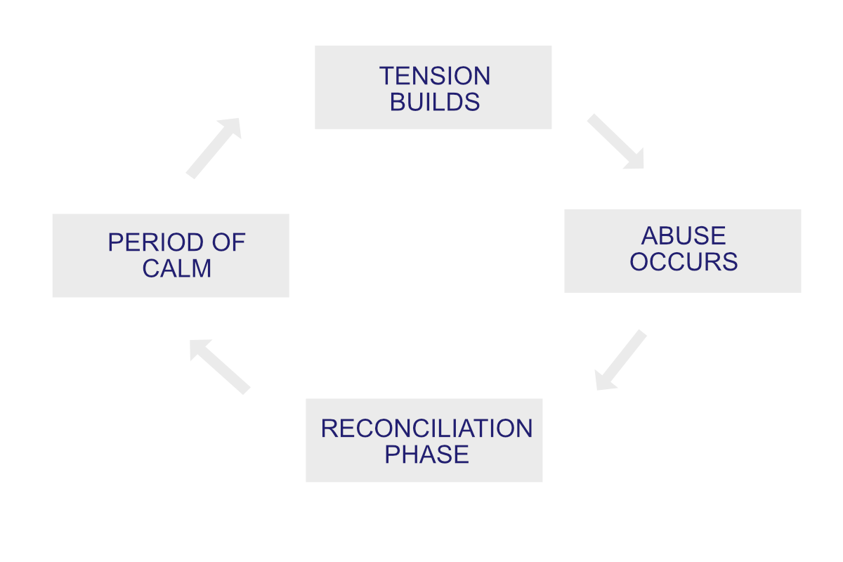
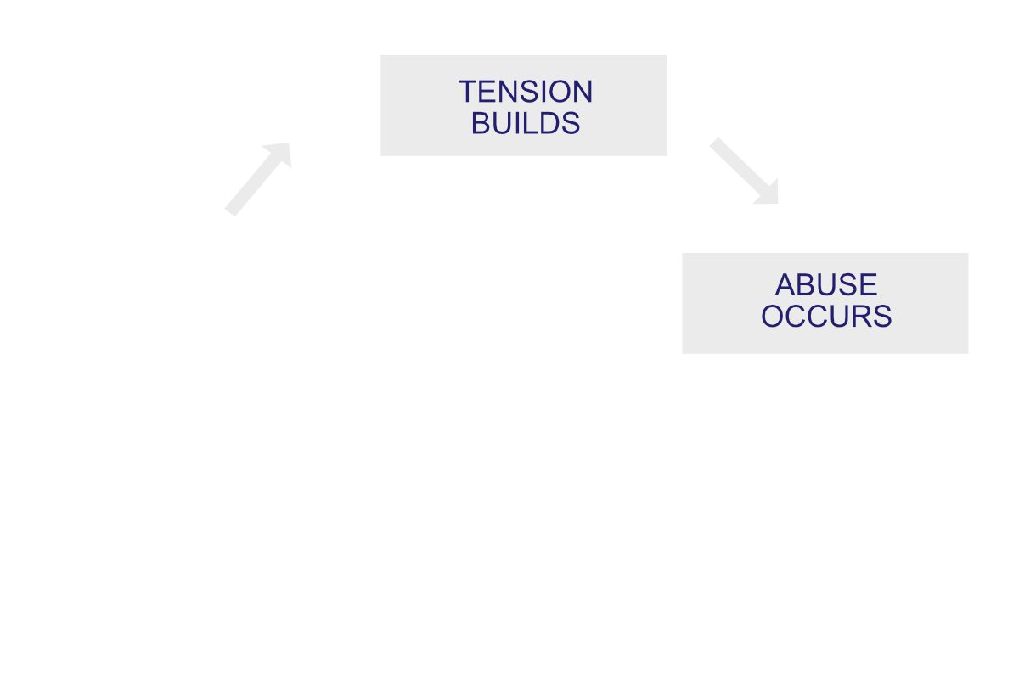

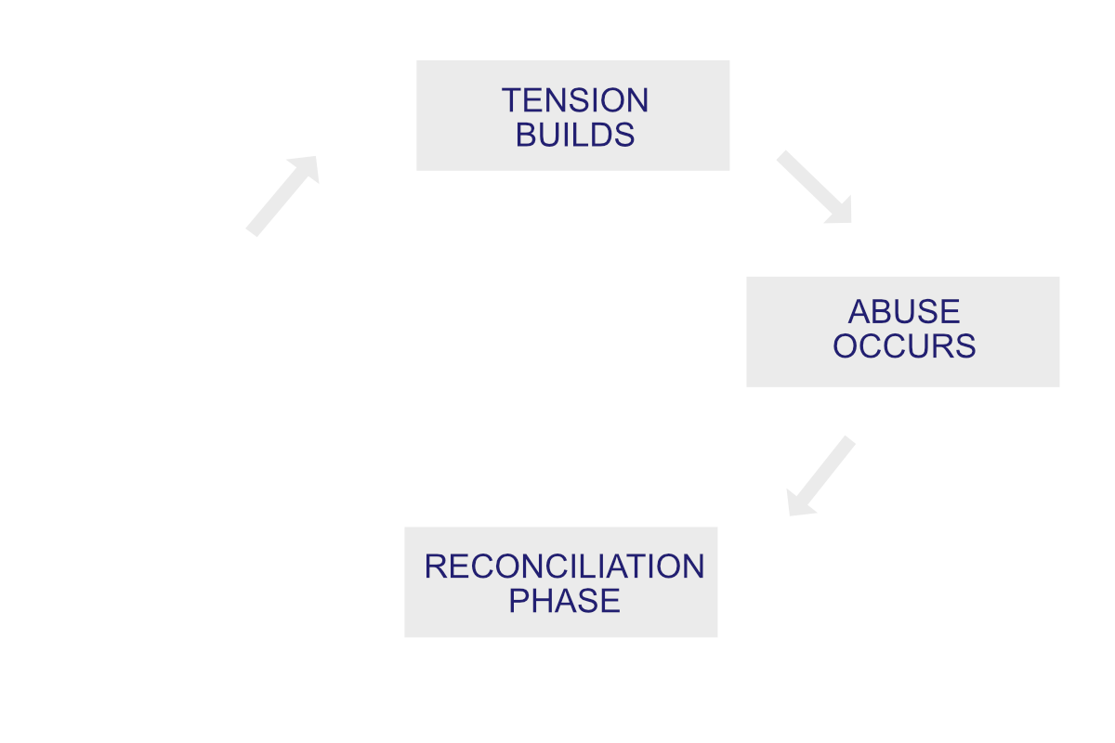
Raising Awareness of Domestic Abuse
Raising Our Awareness
Part 2: The dynamics of domestic abuse

Slide 14
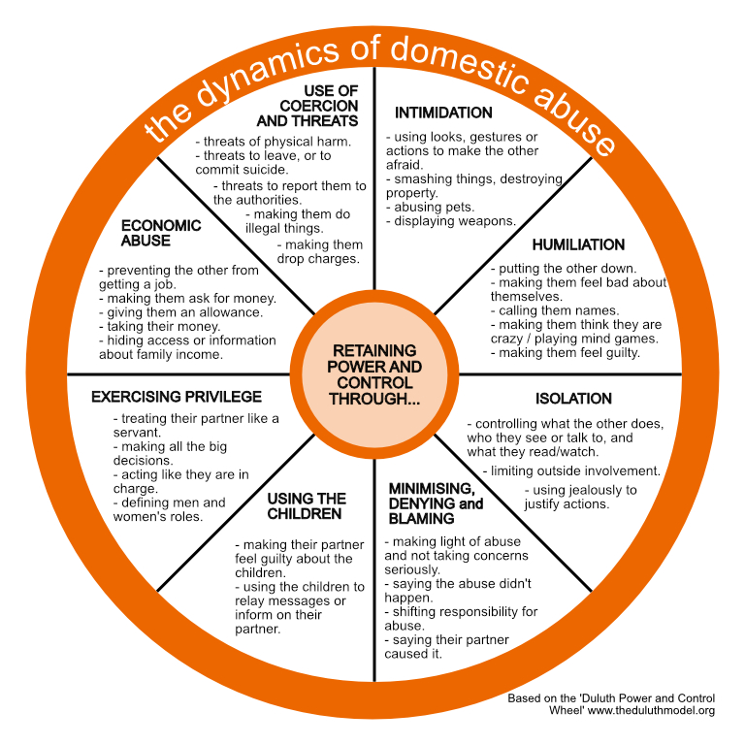
Raising Awareness of Domestic Abuse
Signs That Someone May Be Abusing Their Partner
Part 2: The dynamics of domestic abuse
Notes:
Online course has the image (“Duluth PowerControl revamped.jpg”) available to download

Slide 15
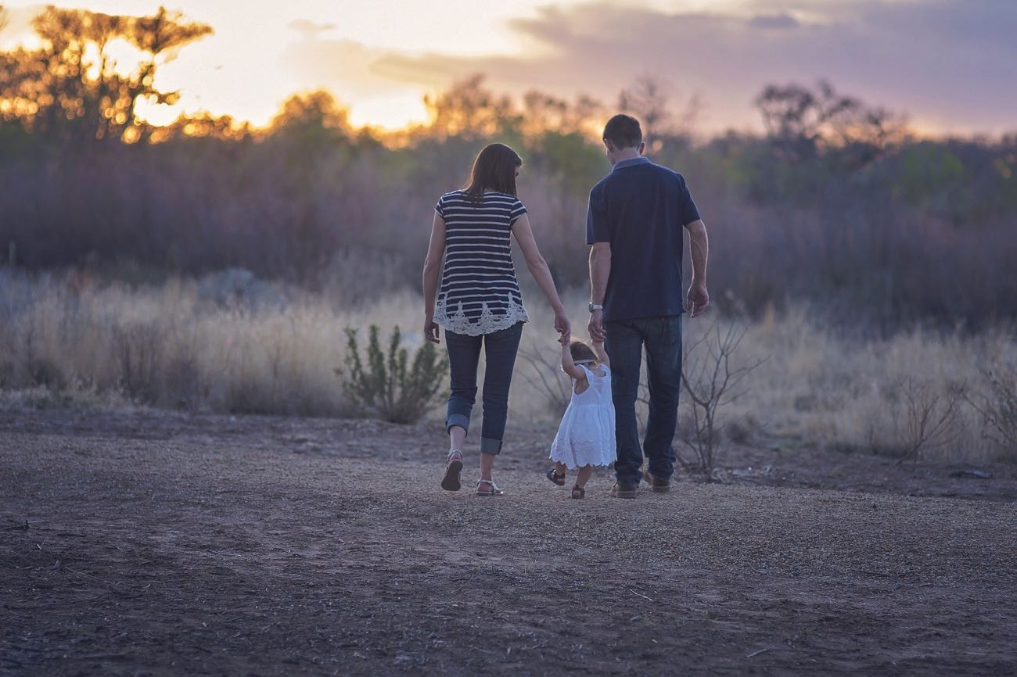

Raising Awareness of Domestic Abuse
Domestic Abuse and Children
Children cannot be direct victims of domestic abuse. Nevertheless, they can suffer deep and long-lasting impacts from an environment in which they witness domestic abuse.
These experiences are considered to fall within statutory categories of ‘child abuse’.
Research suggests that around 1 in 5 children has experienced abuse in this way.
The physical, psychological, and emotional effects on children as a result of exposure to domestic abuse can be severe and long-lasting.
Children may become withdrawn and find it difficult to communicate, act out aggression or blame themselves.
They are experiencing high levels of stress.
Children pick up signs and can feel tension at a young age; and they can learn coping behaviours.
Part 2: The dynamics of domestic abuse

Slide 16
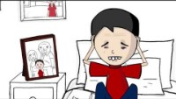
Raising Awareness of Domestic Abuse
Adverse Childhood Experiences (video)
Part 2: The dynamics of domestic abuse

Slide 17
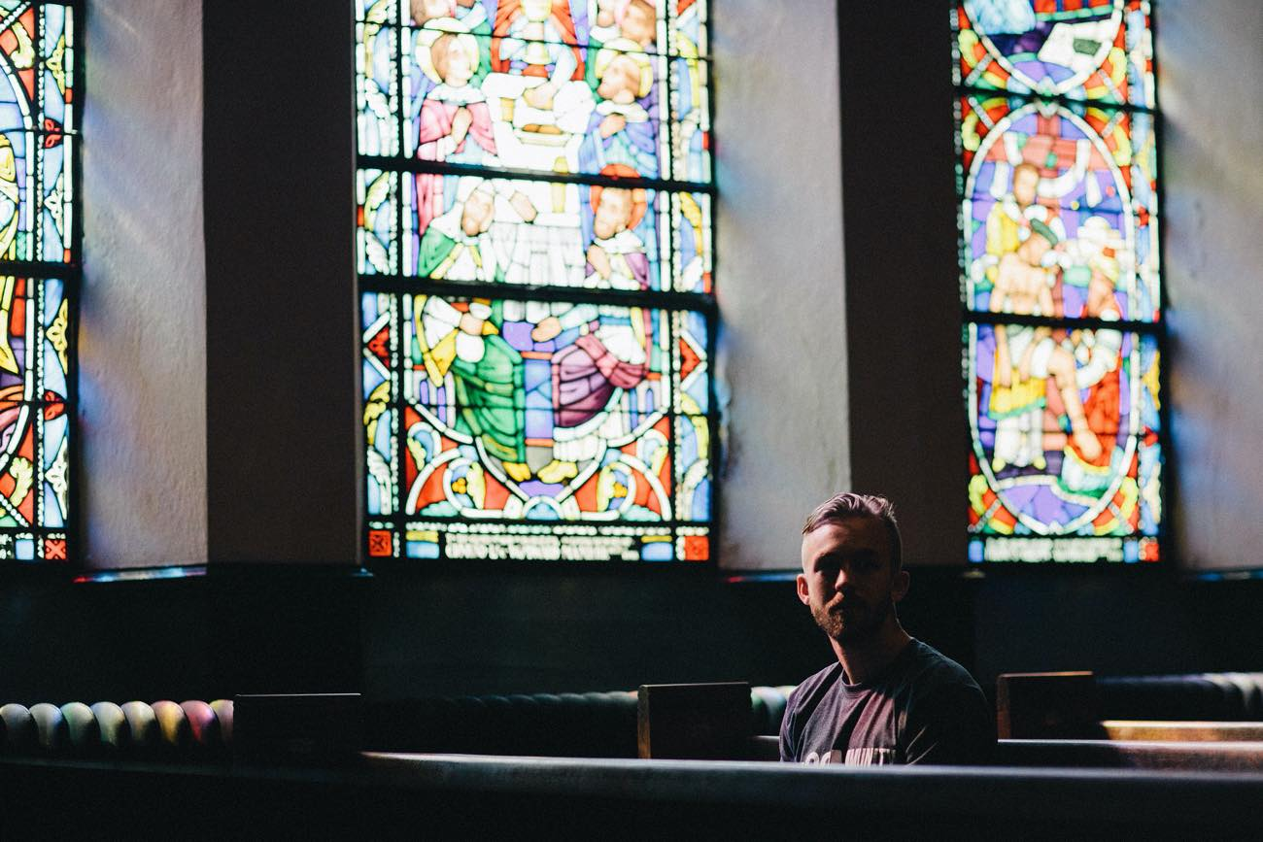
Raising Awareness of Domestic Abuse
Review Your Learning: Part 2 – Scenario, Sean’s Story
You are member of a team who opens up your church building as a quiet space for reflection for the general public. One morning a member of your congregation, Sean, comes in and sits down by themselves. Sean and Linda (his partner) are regular attendees at your church and play an active role in the church’s ministry, helping out with the youth groups and hosting a house group regularly.
After a sitting in the quiet for a short while he breaks down in tears.
You approach him and asked him what is wrong. Sean explains that, the night before (after a house group meeting) Linda accused him of flirting with another woman who had attended.
When Sean denied that he had acted in way inappropriately Linda physically attacked him leaving bruises and scratch marks on his face and body. Their son had been in the other room sleeping but was woken up by Linda’s shouting and screaming.
Review Your Learning: Part 2 – Scenario, Sean’s Story

Slide 18
Raising Awareness of Domestic Abuse
Review Your Learning: Part 2, Sean’s Story (question 1 of 3)
Reflecting on the situation you have just read / listened to, what are your first thoughts and what concerns do you have?
Select 2 from the options below:
                Linda has physically abused Sean, and this not only raises safeguarding concerns for Sean, but also for their son.
                This sounds like a complex situation that may have significant implications for Linda and Sean's involvement in the youth ministry.
                It is highly unlikely that a woman would be able to overpower a man and injure him in this way. There must be some other reason for Sean's injuries and emotional state.
                Linda's treatment of Sean is justified and understandable, given the seriousness of Sean's behaviour.
Review Your Learning: Part 2, Sean’s Story (question 1 of 3)
Notes:
Answer: 1,2

Slide 19
Raising Awareness of Domestic Abuse
Review Your Learning: Part 2, Sean’s Story (question 2 of 3)
Sean goes on to explain that he has been feeling trapped by Linda for some time. Within the past year, she started demanding access to his mobile phone to check who he has been speaking with, saying that he can't be trusted, and that he is lucky to have her in his life. Sean says that he has never had an affair and doesn't understand why she is so suspicious and controlling.
What are your thoughts about this?
                This sort of behaviour fits a pattern of controlling behaviour that may be cause for further concern.
                I think that Linda wants open, transparent and accountable in their relationships with other people, as couples should be.
Review Your Learning: Part 2, Sean’s Story (question 2 of 3)
Notes:
Answer: 1

Slide 20
Raising Awareness of Domestic Abuse
Review Your Learning: Part 2, Sean’s Story (question 3 of 3)
Given all you have heard so far, what are your next steps going to be?
Select 3 from the options below:
                Reassure Sean, and offer further support at any time, should he need someone to talk to.
                Ask Sean if Linda has ever been physically violent towards their son.
                Explain to Sean that you need to make some notes and pass this to your safeguarding officer, who will be in a position to help further.
                Ask Sean what he would like to happen next, and what his concerns are.
Review Your Learning: Part 2, Sean’s Story (question 3 of 3)
Notes:
Answer: 1,3,4

Slide 21


Raising Awareness of Domestic Abuse
Pause and Reflect
Take the opportunity to have a break and digest the content of the course so far...
What has been the most significant aspect of the course so far?
How have the issues raised challenged your faith?
Have they highlighted anything in particular in your own community?
Is there any action you need to take?
Pause and Reflect

Slide 22

Raising Awareness of Domestic Abuse
What Is So-called ‘Honour Based’ Abuse?
Family violence against women and girls is part of domestic abuse. It includes:
Forced marriage.
Female genital mutilation (FGM).
So-called "honour-based" abuse.
  Within UK law, all of these are criminal acts.
  'Honour-based' abuse is carried out in order to protect the so-called “honour” of a family or community.
  ‘Honour crimes’ are most prevalent within diaspora communities from South Asia, the Middle East, and North and East Africa.
Women can be subjected to honour-based punishments for trying to:
  Divorce or separate
  Start a new relationship
  Talk to or interact freely with men
  Have relationships or marry outside a particular religion
  Have sex before marriage
  Marry a person of their own choice
  Attend college or university
  Men CAN also be victims of so-called "honour-based" crimes
Part 3: So-called ‘Honour Based’ abuse

Slide 23

Raising Awareness of Domestic Abuse
Forced Marriage
Forced marriage is where someone is forced to marry against their will, usually by parents, family, or religious leaders
  Victims can be subject to threats, physical or sexual violence, or emotional or psychological blackmail, if they resist.
  Forced marriage is not a problem specific to one country or culture.
  Most forced marriages involving British girls and women take place abroad.
Part 3: So-called ‘Honour Based’ abuse

Slide 24
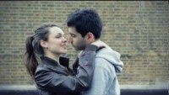
Raising Awareness of Domestic Abuse
Right to Choose (video)
Part 3: So-called ‘Honour Based’ abuse

Slide 25

Raising Awareness of Domestic Abuse
Female Genital Mutilation (FGM)
Female genital mutilation (FGM) is where the female genitals are deliberately cut for non-medical reasons.
    = Cleanliness.
    = Religious requirements.
    = Ensuring chastity.
    = Protecting family honour.
    = Better marriage prospects.
It can have serious health effects and even lead to death.
FGM is abuse. When carried out on girls, it is child abuse. It has been illegal in the UK since 1985.
  FGM offers no health benefits. It is recognised internationally as a human rights violation.
  FGM is mainly practised in at least 29 countries in the western, eastern and north-eastern regions of Africa, in some countries in the Middle East and Asia, and amongst migrants from these areas.
Part 3: So-called ‘Honour Based’ abuse

Slide 26

Raising Awareness of Domestic Abuse
FGM Testimony (video)
Part 3: So-called ‘Honour Based’ abuse

Slide 27

Raising Awareness of Domestic Abuse
Recognising the Signs of ‘Honour Based' Abuse
Excessive parental restrictions
- Siblings marrying early.
- Restriction on friendships.
- Disapproval of adopting 'western
appearance.
Employment issues
- Poor attendance or performance.
- Parental control of income and choices.
- Being accompanied to and from work.
Educational engagement
- Extended absences, decline in
performance.
- Anxiety about holidays.
- Being accompanied to and from school.
Family Conflicts
- Domestic abuse or violence.
- Running away from home.
- Frequent 'accidental' injuries.
Psychological distress
- Self harm, depression or attempted suicide.
- Social isolation.
- Eating disorders or substance abuse.
Part 3: So-called ‘Honour Based’ abuse

Slide 28
Raising Awareness of Domestic Abuse
Review Your Learning: Part 3 (question 1 of 3)
Based on what learned in this part of the course, how would you explain so called 'honour abuse'?
Select 3 from the options below:
                'Honour based' abuse is carried out in order to protect the so-called “honour” of a family or community.
                So called 'Honour based' abuse includes FGM (Female Genital Mutilation) and forced marriage as well as other dynamics that would fall under the UK legal definition of 'Coercion and Control'.
                So called 'Honour-based' abuse only happens to women and girls.
                'Honour' codes are commonly set by the male members of families, and often specify lifestyle choices that are required by women and girls.
Review Your Learning: Part 3 (question 1 of 3)
Notes:
Answer: 1,2,4

Slide 29
Raising Awareness of Domestic Abuse
Review Your Learning: Part 3 (question 2 of 3)
What are some of the common reasons given to justify FGM (Female Genital Mutilation) in the minds of perpetrators?
Select all that apply:
                Better marriage prospects.
                Protecting family honour
                Health reasons.
                Religious requirements.
Review Your Learning: Part 3 (question 2 of 3)
Notes:
Answer: 1,2,3,4

Slide 30
Raising Awareness of Domestic Abuse
Review Your Learning: Part 3 (question 3 of 3)
In light of what you know about so called 'honour based' abuse, what sort of situations might give you immediate cause for concern?
Select 2 from the options below.
                A teenage girl whose family are from Malawi whose uncle accompanies her to and from school every day, and has no access to a mobile phone.
                A young woman from a Muslim background is unhappy about moving to Saudi Arabia with their family.
                A young mother who explains that her husband would be unhappy with her attending the local toddler group.
                A teenage Pakstani girl visits a school counselling service and is found to be suffering from depression, and has just started self-harming.
Review Your Learning: Part 3 (question 3 of 3)
Notes:
Answer: 1,3

Slide 31

Raising Awareness of Domestic Abuse
Pause and Reflect
Take the opportunity to have a break and digest the content of the course so far...
What has been the most significant aspect of the course so far?
How have the issues raised challenged your faith?
Have they highlighted anything in particular in your own community?
Is there any action you need to take?
Pause and Reflect

Slide 32
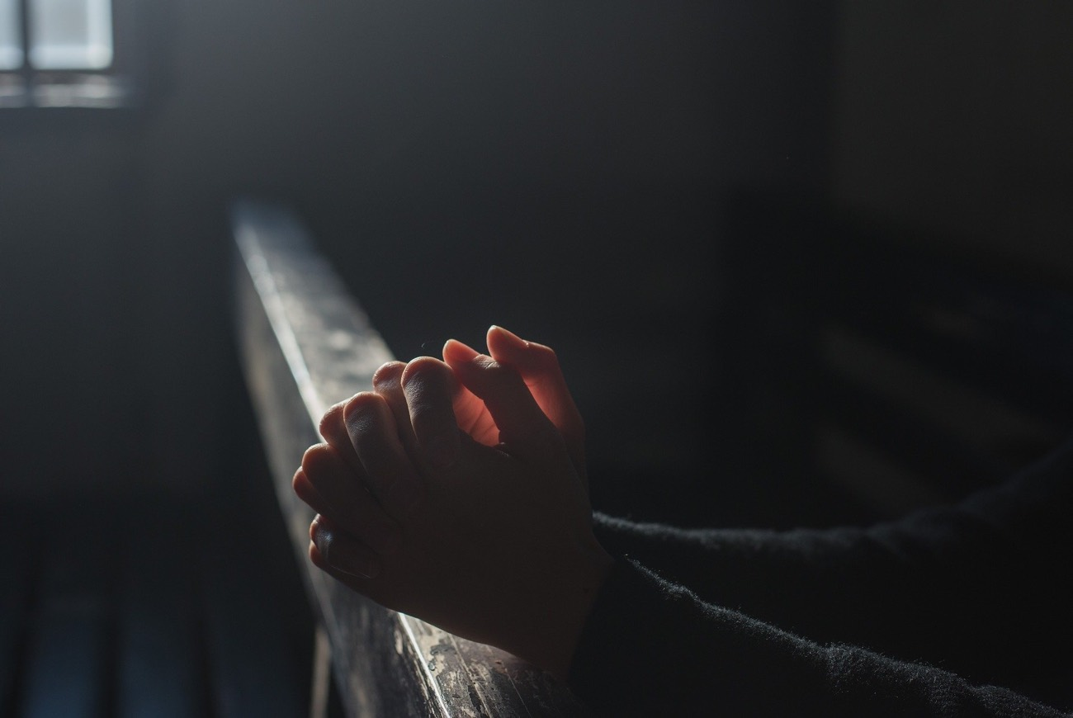
Raising Awareness of Domestic Abuse
Survivors in Church Communities
The abuse went on for six years before I realised that what I was experiencing wasn’t just a bad marriage. Everyone says marriage is difficult so at first I thought it was that – our adjustment to married life.
There was pressure to make marriage work and to sacrifice yourself. After all the church says ‘till death us do part’. I bent over backwards to make it work.
From the outside most people thought we were the perfect happy couple. But I was walking on eggshells in my own home, never knowing what mood he would be in when he came home.
It was such a lonely time. I didn’t think anyone would believe me if I told them what it was really like at home. I was desperate for some hope.
Part 4: Domestic abuse and the Christian church

Slide 33


Raising Awareness of Domestic Abuse
Christian Beliefs and Culture
Faith and scripture cannot, under any circumstances, be used to justify, excuse or deflect responsibility for abuse.
  A priority on relationships, family and marriage in church can make it difficult to tell others that things are bad at home.
  People may feel they are 'letting the church down' or 'failing’.
  Giving survivors false or unrealistic hopes about change.
Negative impacts of faith on domestic abuse
  Christian teaching has been used to give, or resulted in giving, ‘permission to abuse’.
  Survivors can feel immense guilt for breaking off the marriage and may stay longer in abusive relationships.
  This can be reinforced by their church’s teaching on divorce, re-marriage or forgiveness.
Part 4: Domestic abuse and the Christian church

Slide 34


Raising Awareness of Domestic Abuse
Gender, Sexuality and the Church
In the church, as in society, there still exist barriers in organisations and institutions that need to be broken down so that people can feel supported when they are in crisis.
  There are both 'actual' and 'percieved' barriers to support for those from LGBTQI+ backgrounds.
  Tensions between faith, gender and sexuality can make it harder to seek support.
  Those in LGBTQI+ communities may have to “come out” in order to disclose abuse.
Part 4: Domestic abuse and the Christian church

Slide 35
Raising Awareness of Domestic Abuse
Review Your Learning: Part 4 (question 1 of 3)
In this part of the course, we have thought about some of the reasons why there can be additional barriers to disclosure of domestic abuse within the Christian church.
Select 3 from the options below:
                Church leaders (vicars, priests) are not as available as they should be to hear the stories of those who are suffering.
                Church teaching can be used by perpetrators as a lever to keep a partner in an abusive relationship.
                Theological issues relating of sexuality and/or gender can mean that those from LGBTQI+ backgrounds may find it difficult to raise concerns.
                Many people in the church find it difficult to acknowledge marital difficulties because of a fear of failure.
Review Your Learning: Part 4 (question 1 of 3)
Notes:
Answer: 2,3,4

Slide 36
Raising Awareness of Domestic Abuse
Review Your Learning: Part 4 (question 2 of 3)
What do you think are some of the positive roles that the church community could play in relation to domestic abuse?
Select 2 from the options below:
                Change its ideals and teaching about marriage being a lifelong faithful commitment.
                Model healthy relationships, and create safe spaces for all people, regardless of their faith background.
                Whilst it is true that restoration of relationships is possible, we need to recognise that many people need to be protected from, or helped to leave, an abusive situation.
Review Your Learning: Part 4 (question 2 of 3)
Notes:
Answer: 2,3

Slide 37
Raising Awareness of Domestic Abuse
Review Your Learning: Part 4 (question 3 of 3)
True or false?
Somebody who is suffering from domestic abuse is far more likely to talk to a trusted friend about their situation, so it is beneficial for as many people as possible in your congregation to be aware of the issues and dynamics of domestic abuse within church contexts.
Review Your Learning: Part 4 (question 3 of 3)
Notes:
Answer: true

Slide 38
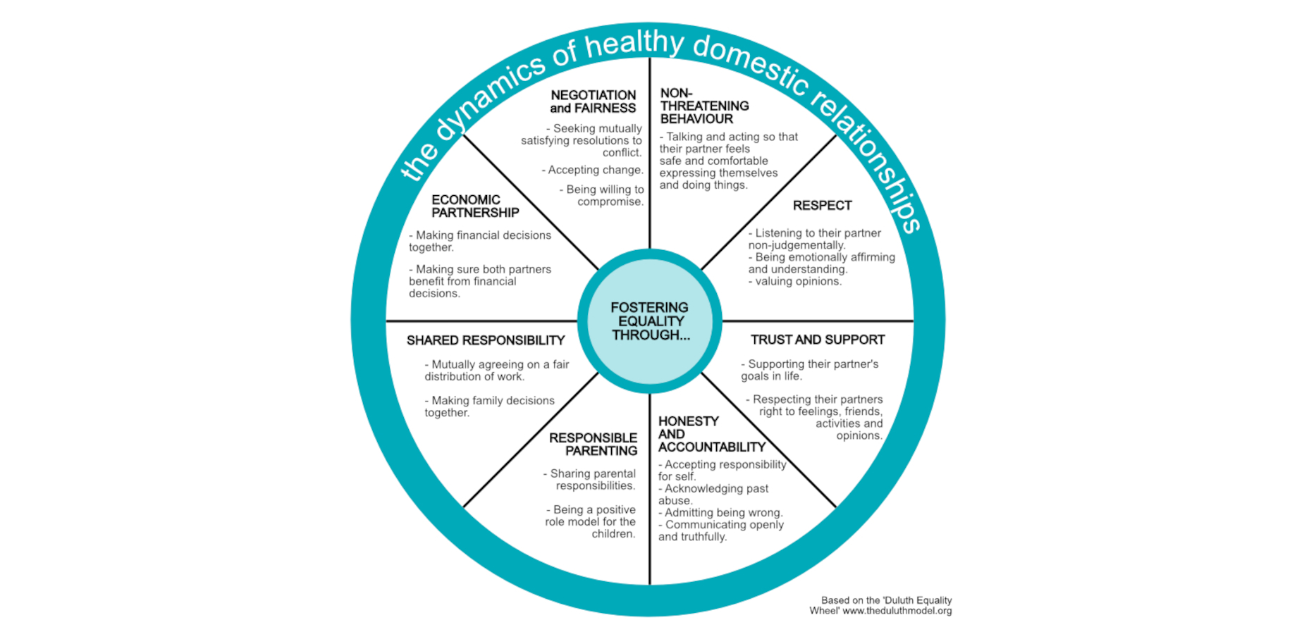
Raising Awareness of Domestic Abuse
Supporting Healthy Relationships
Christian families experiencing domestic abuse are as complex, if not more complex, than those outside the church community.
  The church is called to embody and develop loving and just relationships.
  Living out a sustaining spirituality rooted in the language and shared experience of God’s love in Christ.
  Building others up, practising empathy and using power to protect the vulnerable.
  Creating a healthy culture where positive relationships include permission to talk about struggles, difficulties and disclose abuse.
  We want all who participate or connect with the Christian community to be able to find safety, healing and restoration.
Part 5: The role of the Christian community
Notes:
Online version has “DuluthEquality2.jpg” as a download here

Slide 39

Raising Awareness of Domestic Abuse
Supporting Awareness and Action
In governance
Appoint a Parish Safeguarding Officer.
Work with your Diocesan Safeguarding Advisor.
Discuss these issues at PCC or Chapter.
Agree a domestic abuse statement.
Adopt good safeguarding procedures and ensure training is up to date.
In partnerships
Make sure your church knows how to contact their local Domestic Abuse specialist service provider.
Place contact information or leaflets in public places in your building(s).
In learning and discipleship
Include in your youth/children's ministry programme.
Include in adult small group settings.
Ensure appropriate people get training.
Financial giving or volunteering.
Pray and teach publicly about these issues.
Part 5: The role of the Christian community

Slide 40
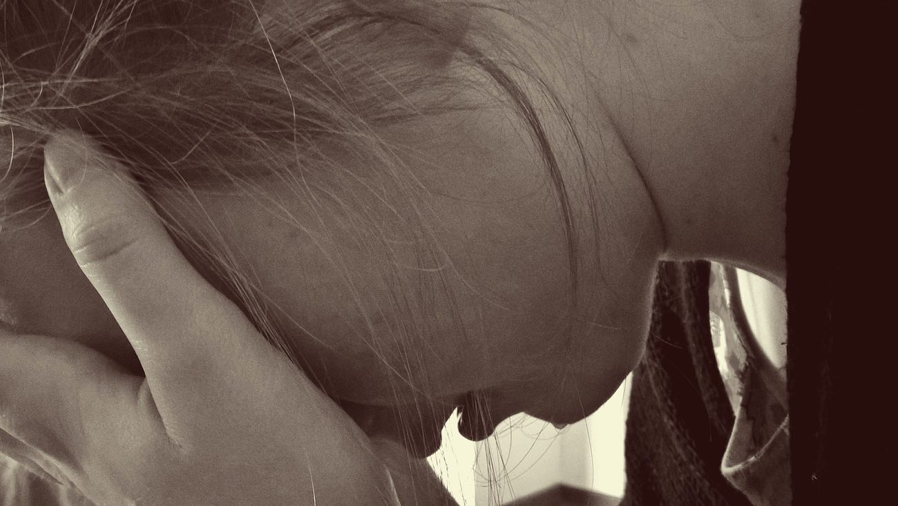
Raising Awareness of Domestic Abuse
Direct Intervention – Helping Someone Talk About It
If you ask someone whether they are suffering from abuse, they are more likely to admit it than if you wait for them to say something.
Face to face, in a safe space where you won't be interrupted.
Approach the subject with obvious kindness and concern.
"We haven’t seen much of you recently, is everything ok?"
"I’ve noticed you seem a bit down, has anyone upset you?"
Part 5: The role of the Christian community

Slide 41


Raising Awareness of Domestic Abuse
Direct Intervention – Handling Disclosure (The 4 Rs)
Recognise
Respond
Record
Refer
Recognise
Respond
Record
Refer
Recognise
Accept and take seriously what is being said without displaying shock or disbelief.
Let the person tell their story and don’t push for information or ask leading questions.
Do not interrogate or decide if they are telling the truth.
Be alert to signs and symptoms of abuse.
Respond
Reassure the individual they have taken the right step in sharing this information and they are not to blame.
Respond (cont.)
Be honest; never make promises to keep what you are being told confidential. If abuse is involved, you will need to tell someone.
Tell them what you will do with the information they have shared and that they will be kept informed.
Do not introduce personal information or from either your own experience or that of others.
Do not investigate the matter any further for yourself, or approach the person about whom allegations may have been made.
Record
Write down, concisely, exactly what is seen, said or heard and make clear where you have added your views or interpretation.
You may find it helpful to use the 4 W’s, as follows:
WHO was involved? Name the key people
WHAT happened? Facts not opinions
WHEN did it happen? Date and time
WHO have you referred the issue on to?
Refer
Pass the information to the Safeguarding Lead or Diocesan Safeguarding Advisor in your setting within 24 hours
In case of an emergency call the Police or dial 999.
Part 5: The role of the Christian community
Notes:
Once this slide has loaded, the first click will bring in the large headings automatically, and the second will make the first column appear.

Slide 42


Raising Awareness of Domestic Abuse
Direct Intervention - Helping Someone Leave an Abusive Relationship
Escaping or leaving a domestic abusive relationship can be incredibly dangerous and professional help is almost certainly required.
41% (37 of 91) of women killed by a male partner/former partner in England, Wales and Northern Ireland in 2018 had separated or taken steps to separate from them. Eleven of these 37 women were killed within the first month of separation and 24 were killed within the first year (Femicide Census, 2020).
Do not judge or remove support...
...even if the person rejects the support or is protective of the perpetrator.
Here are some ways you might help:
Storing an emergency bag for them.
Being with them when they call helplines or support services.
Going with them to appointments.
We must remember that…
Leaving an abusive relationship raises the level of risk of reprisal to both the victim and the person helping.
It can take many attempts to leave; and some never leave at all.
People may also sometimes go back to abusers.
!!DO NOT ACT ALONE!!
Part 5: The role of the Christian community

Slide 43

Raising Awareness of Domestic Abuse
Why Do We Find It Difficult to Act?
#1 = FEAR
Ridicule, false accusations, 'crying wolf' or making a fuss.
Political correctness.
Convincing ourselves to wait, or that it is someone else's job.
Responding well is not an easy thing to do.
Safeguarding involves dealing with uncertainty.
We are all vulnerable to these dynamics.
Part 5: The role of the Christian community

Slide 44
Raising Awareness of Domestic Abuse
Final Assessment - Introduction
Welcome to the start of the final assessment for this course
  In this task, you will be asked to apply all you have learnt so far to safeguarding scenario that involves issues of domestic abuse.
  This assessment, combined with the other questions you have answered so far in this course will be used to determine your final mark.
Final Assessment - Introduction

Slide 45
Raising Awareness of Domestic Abuse
Final Assessment - Scenario
Scenario
You are a volunteer youth worker at a Friday night open access youth club run by your church. One evening you notice a group of girls who regularly attend are comforting one of their group, called Kirstie (age 16), who has just arrived and seems vary shaken up. You approach the group and ask if everything is OK, and whether you can help.
Kirstie explains that her boyfriend Kevin had just driven her to the club in his car at high speed, knowing that she hated it and was petrified. She becomes tearful and goes on to say that at the beginning of their relationship, he seemed so charming – like he wanted to be number 1 in her world - but over time he became more and more possessive - particularly after she moved in to live with him in his flat.
Whenever Kirstie would go out, Kevin would want to know why, where she’d be, and exactly who’d be there. If she came home later than she said, he’d accuse her of having an affair. If he’d been drinking, he’d call her names. He would shout, swear and square up to her. This is now happening multiple times a week.
She says that Kevin was always sorry and say he “felt so bad - he’d never do it again”. Kirstie says that she feels like this is all her fault, because Kevin often also says that she makes him angry.
Final Assessment - Scenario

Slide 46
Raising Awareness of Domestic Abuse
Final Assessment (question 1 of 3)
What are your concerns?
Select 3 from the options below:
                That Kirstie is 16 and living by herself with her boyfriend.
                That Kirstie is being subject to psychological and emotional abuse, and now facing intimidation on a regular basis in her home.
                That Kevin might be driving under the influence of alcohol.
                That Kirstie feels responsible for her boyfriend’s behaviour.
Final Assessment (question 1 of 3)
Notes:
Answer: 1,2,4

Slide 47
Raising Awareness of Domestic Abuse
Final Assessment (question 2 of 3)
From the options below, select your 2 most immediate courses of action.
                Ask Kirstie's friends to look after her and make sure she is OK, and report back next week when everything has calmed down.
                Check the youth club registration forms for any emergency contact numbers for either a parent or guardian.
                Invite Kirstie to bring one of her friends and sit down somewhere private and discuss this with you further.
Final Assessment (question 2 of 3)
Notes:
Answer: 2,3

Slide 48
Raising Awareness of Domestic Abuse
Final Assessment (question 3 of 3)
Identify any further actions that you should take.
Select 3 from the options below:
                Reassure Kirstie that she has done the right thing in talking about this with you and her friends.
                Ask Kirstie whether or not you have her permission to share what she has told you with your safeguarding officer.
                Ask another member of staff to sit with Kirstie whilst you call the police.
                If possible, as Kirsty to repeat what she has said to you to enable you to make some notes.
Final Assessment (question 3 of 3)
Notes:
Answer: 1,3,4

Slide 49
Raising Awareness of Domestic Abuse
End of Course
Thank you for participating in the Raising Awareness of Domestic Abuse course.
We hope you found it challenging, thought provoking and an encouragement to continue to live and work together to promote healthy, safer and Christ-centred faith communities.
End of Course

