Slide 1
What do these words have in common?
Niue
Kiribati
Tuvalu
Palau
Nauru
Vanuatu

Slide 2
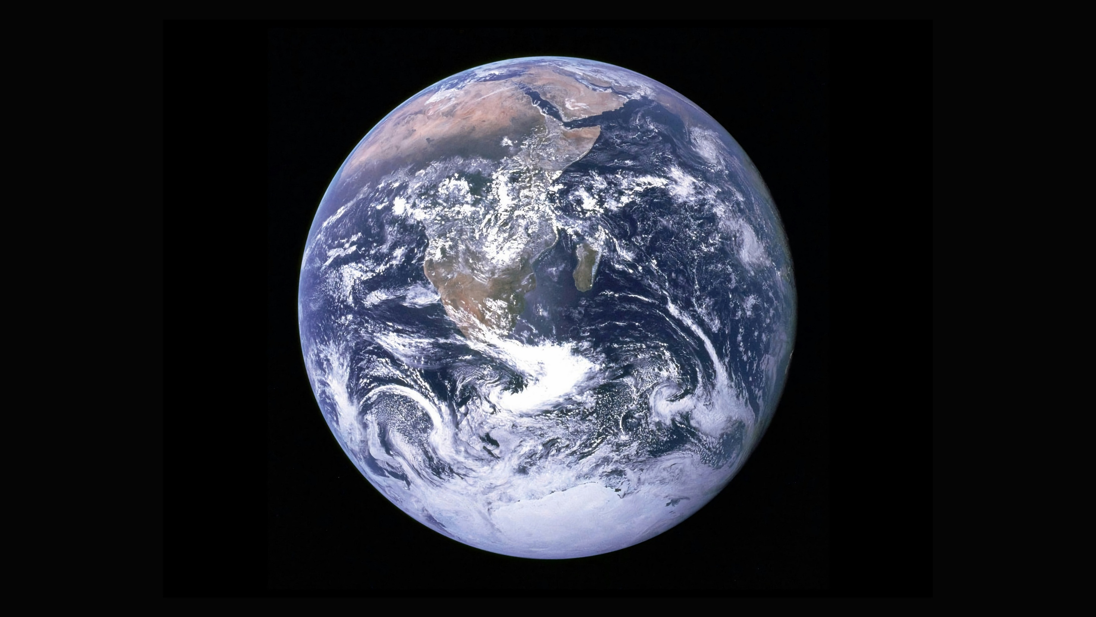
Photo by NASA on Unsplash
Notes:
Then God creates the planet earth and makes the dry land and the seas and the passage says that God saw that it was good.

Slide 3
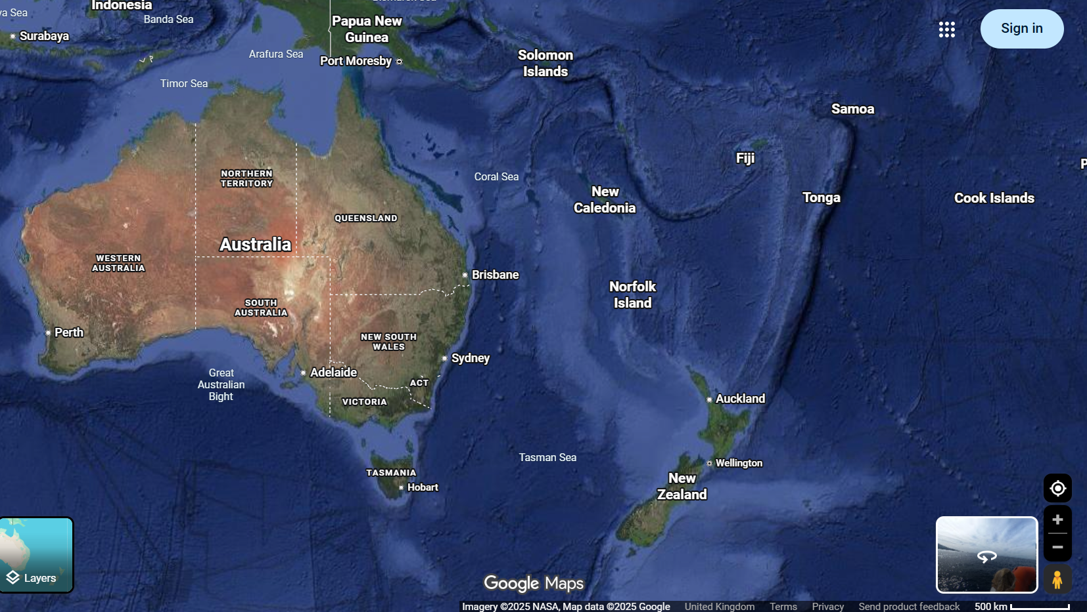
The Pacific Isands
Cook Islands
Fiji
Marshall Islands
Micronesia
Papua New Guine
Samoa
Solomon Islands
Tonga
Kiribati
Nauru
Niue
Palau
Tuvalu
Vanuatu

Slide 4
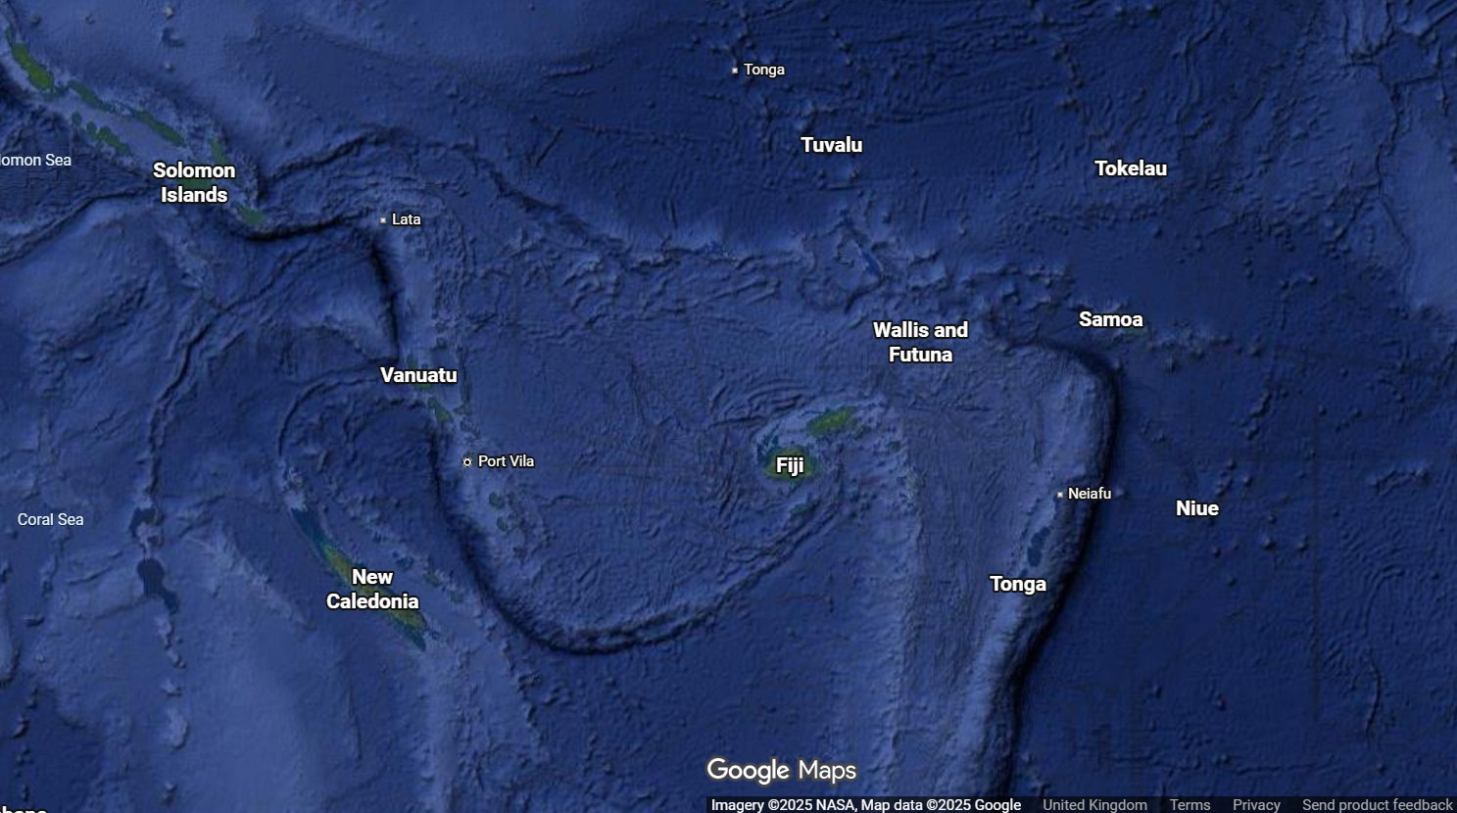
The Pacific Isands
Cook Islands
Fiji
Marshall Islands
Micronesia
Papua New Guine
Samoa
Solomon Islands
Tonga
Kiribati
Nauru
Niue
Palau
Tuvalu
Vanuatu

Slide 5
The Pacific Isands
Cook Islands
Fiji
Marshall Islands
Micronesia
Papua New Guine
Samoa
Solomon Islands
Tonga
Kiribati
Nauru
Niue
Palau
Tuvalu
Vanuatu
How many Pacific Islands are there?
1) 200 2) 2,000 3) 20,000

Slide 6
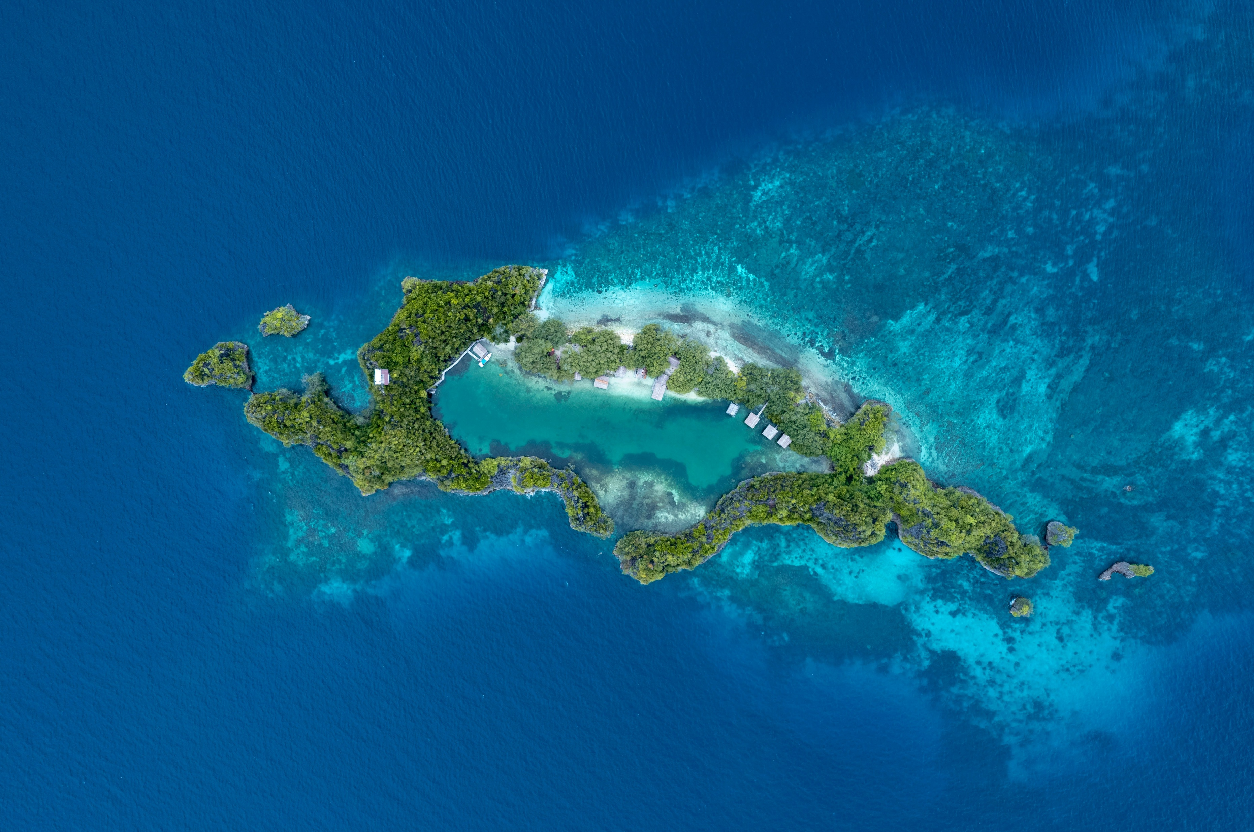
Photo by Ernests Vaga on Unsplash

Slide 7

How long to get there on a plane?
10hours
30hours
50 hours
Photo by Ernests Vaga on Unsplash

Slide 8
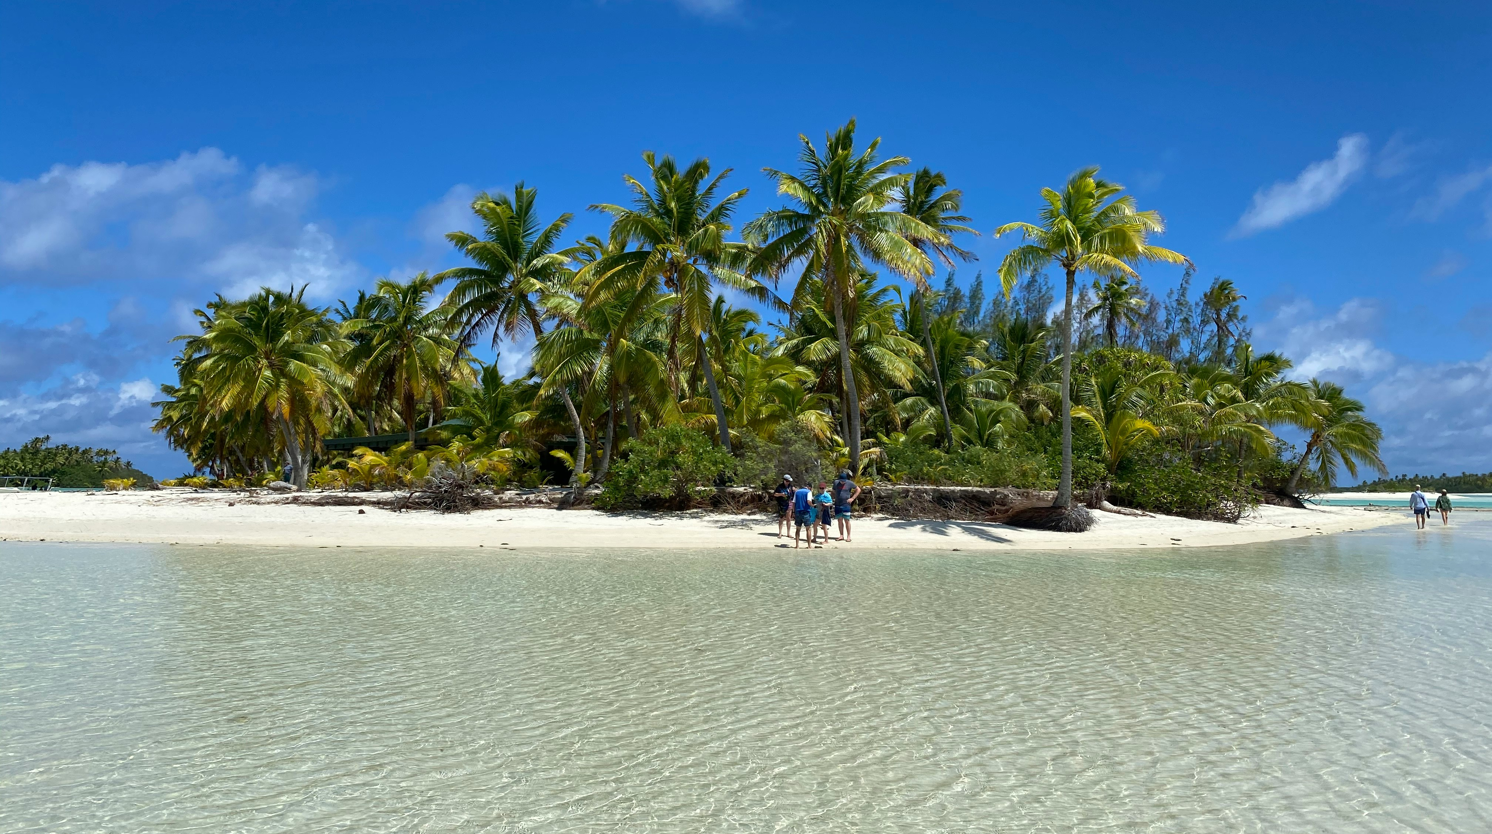
Photo by Christoph Burgdorfer on Unsplash
Photo by Ernests Vaga on Unsplash

Slide 9
How many people live on the Islands
1) 30,000 2)300,000 3)3,500,000, 4)35,000,000
Photo by Christoph Burgdorfer on Unsplash
Photo by Ernests Vaga on Unsplash

Slide 10

From 5 days last year. By 2050 what increase in flood days is expected in Kiribati?
1) 5 2) 15 3) 35 4) 65
Photo by Bernd 📷 Dittrich on Unsplash

Slide 11
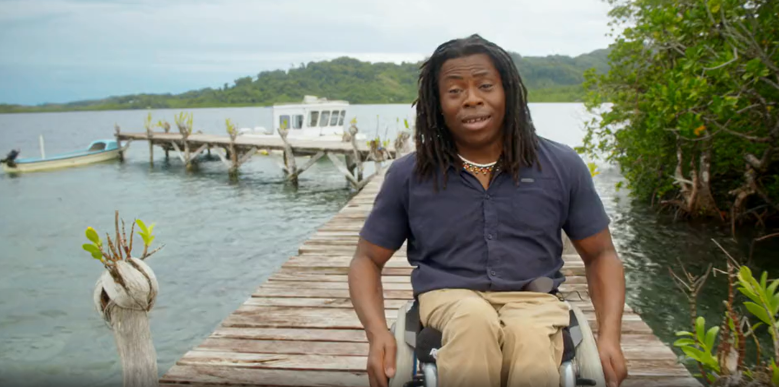
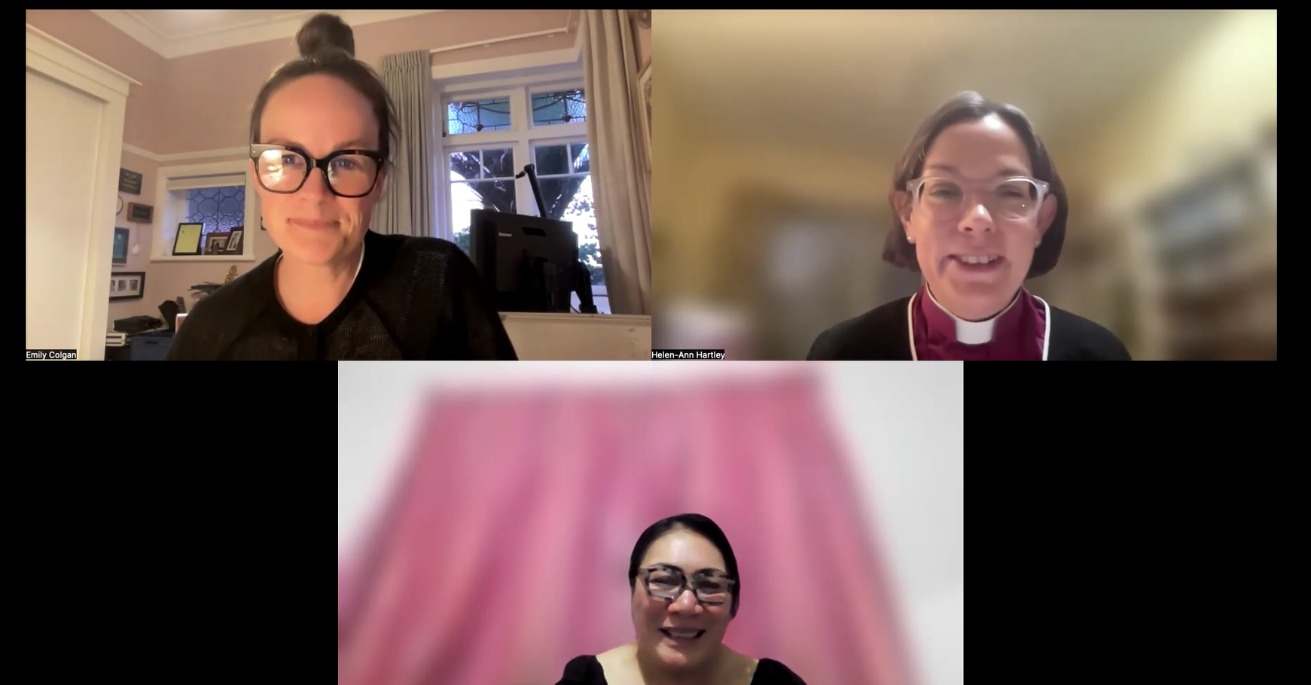
Things to have a look at:
BBC bitesize –
Climate change
Conversation with the Bishop of Newcastle with people of Pacific Islands

Slide 12


Slide 13
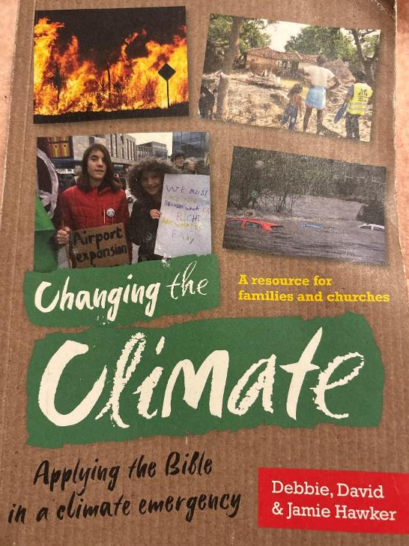
Useful references

Slide 14
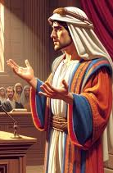
Expert in the law
What must I do to inherit eternal life?

Slide 15
Expert in the law
….and Who is my neighbour?

Slide 16
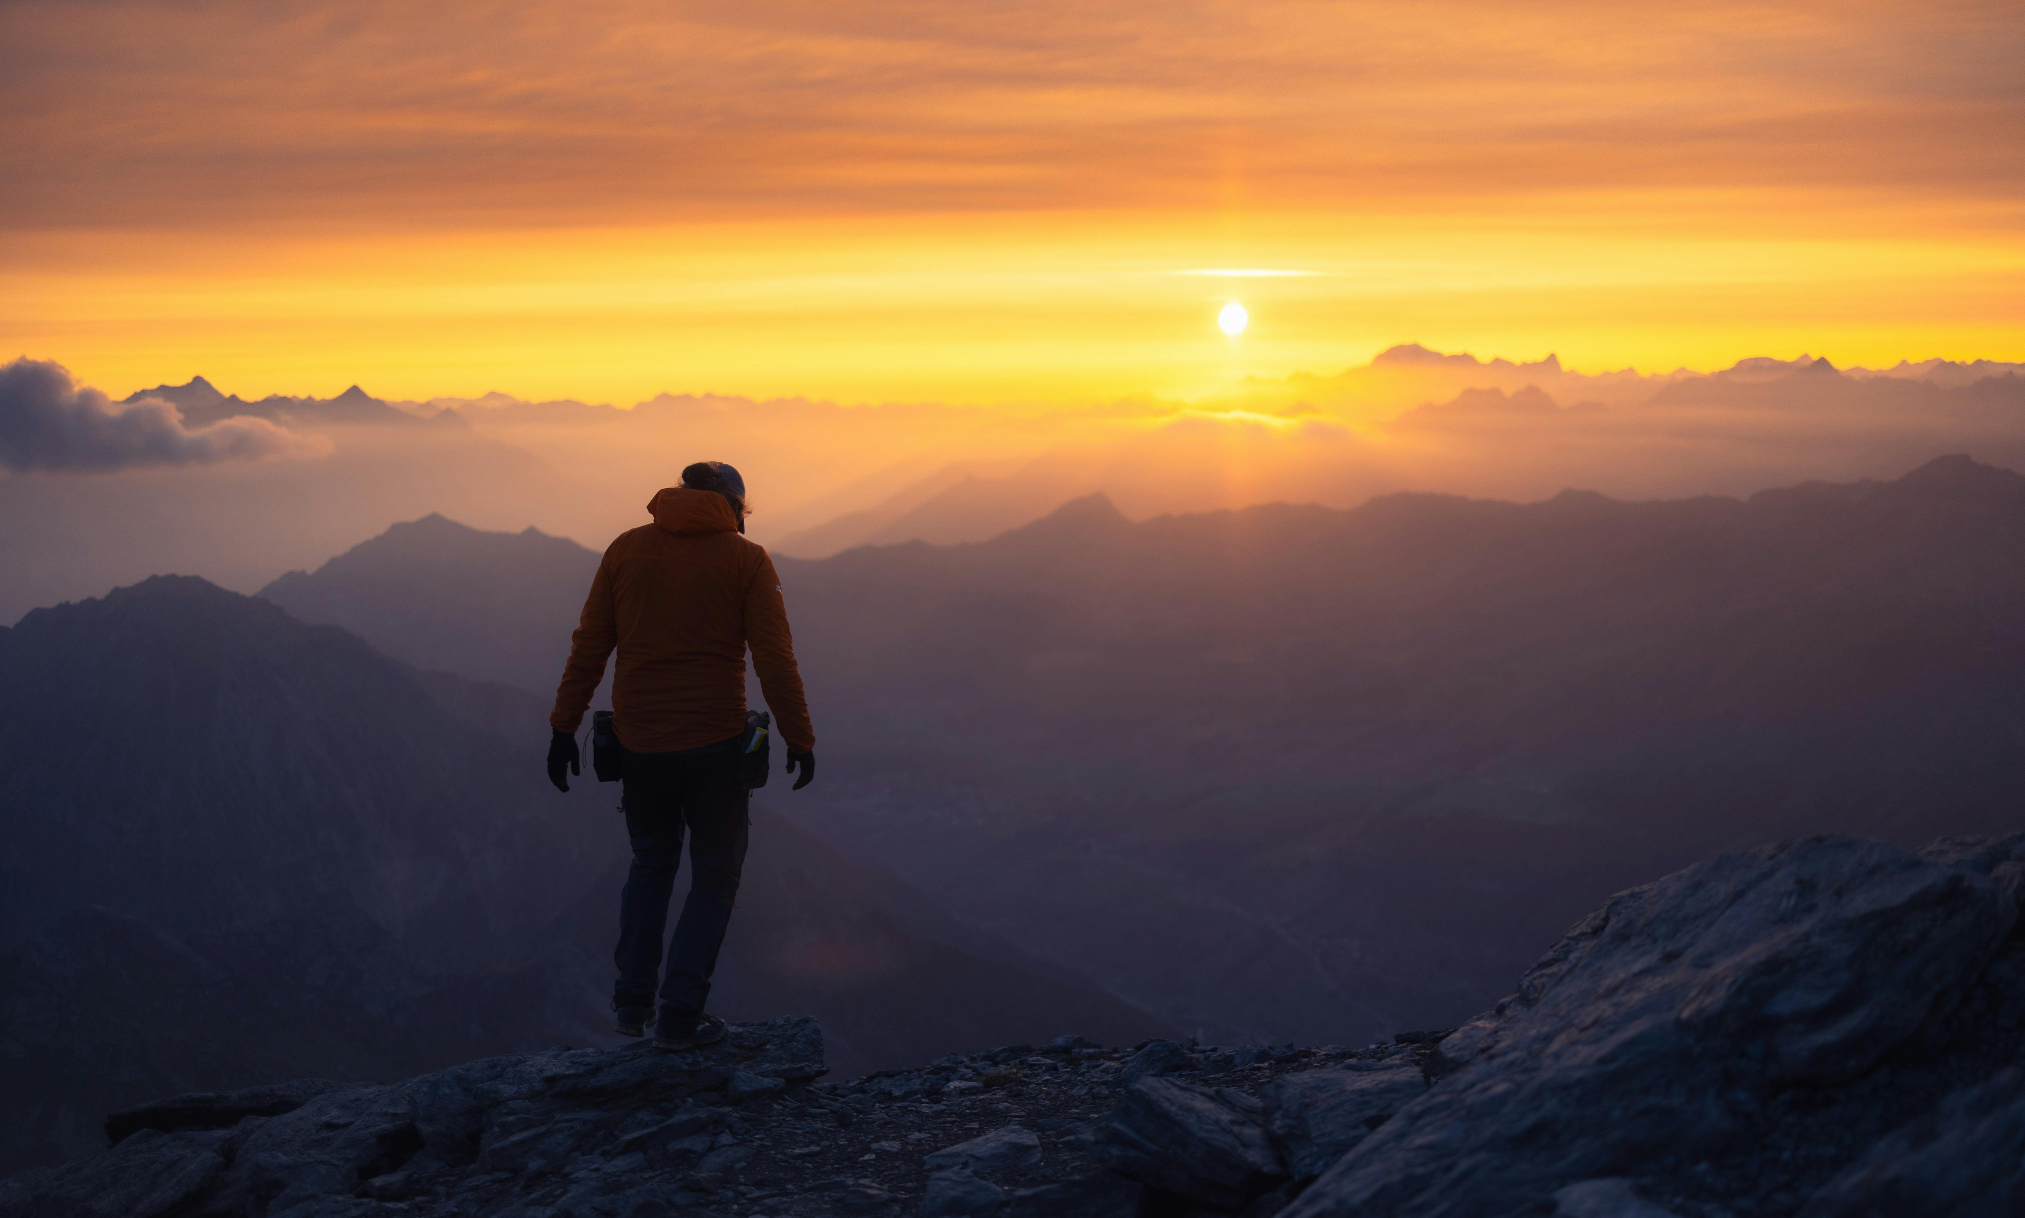
William Henry Margetson
Photo by Marek Piwnicki: https://www.pexels.com/photo/purple-world-18688551/

Slide 17
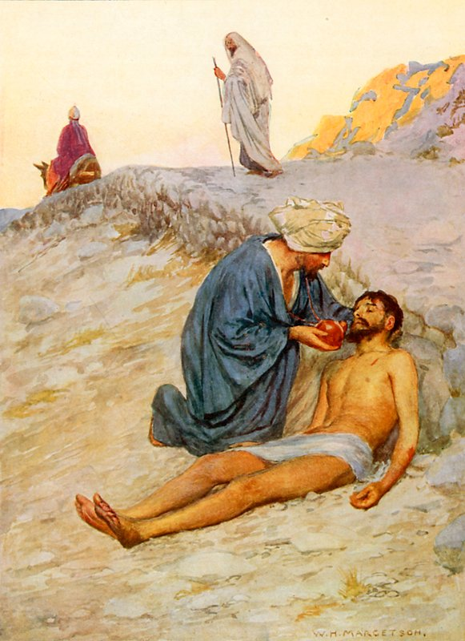
The man

Slide 18
The Priest

Slide 19
The Levite

Slide 20
The Samaritan
William Henry Margetson

Slide 21
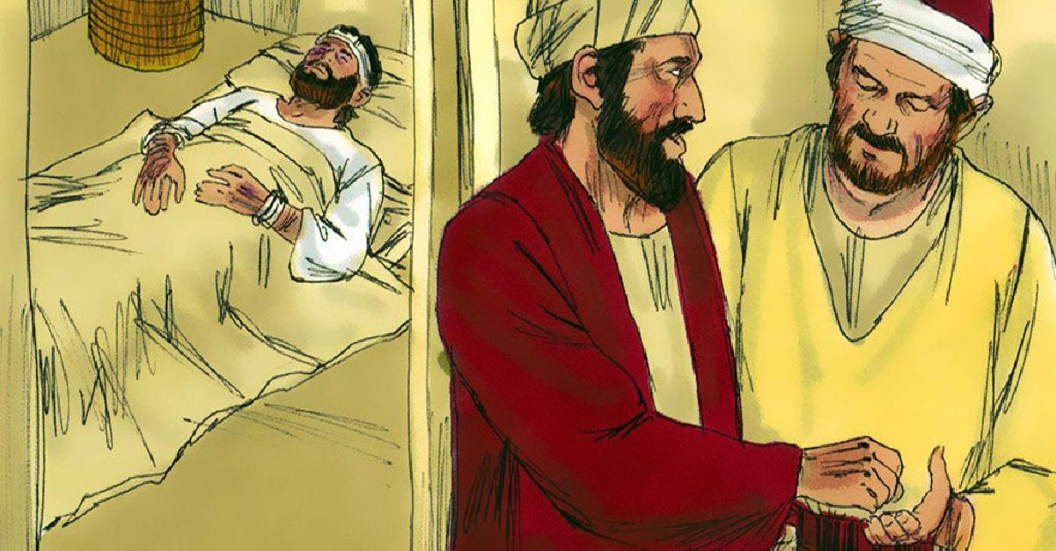
The Innkeeper

Slide 22
William Henry Margetson
Photo by Marek Piwnicki: https://www.pexels.com/photo/purple-world-18688551/

Slide 23
The Priest

Slide 24
The Levite

Slide 25
The Samaritan
William Henry Margetson

Slide 26
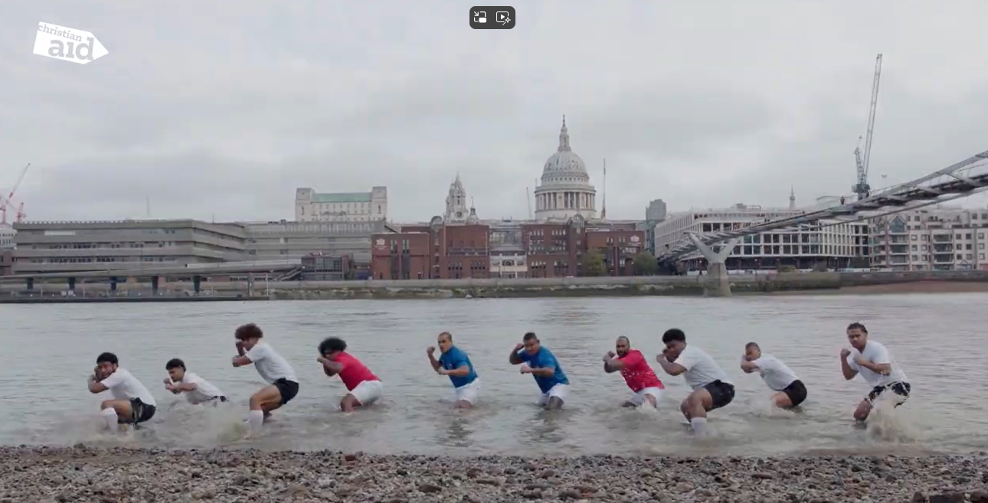
The Innkeeper

Slide 27
Bishop Helen-Ann interview

Slide 28
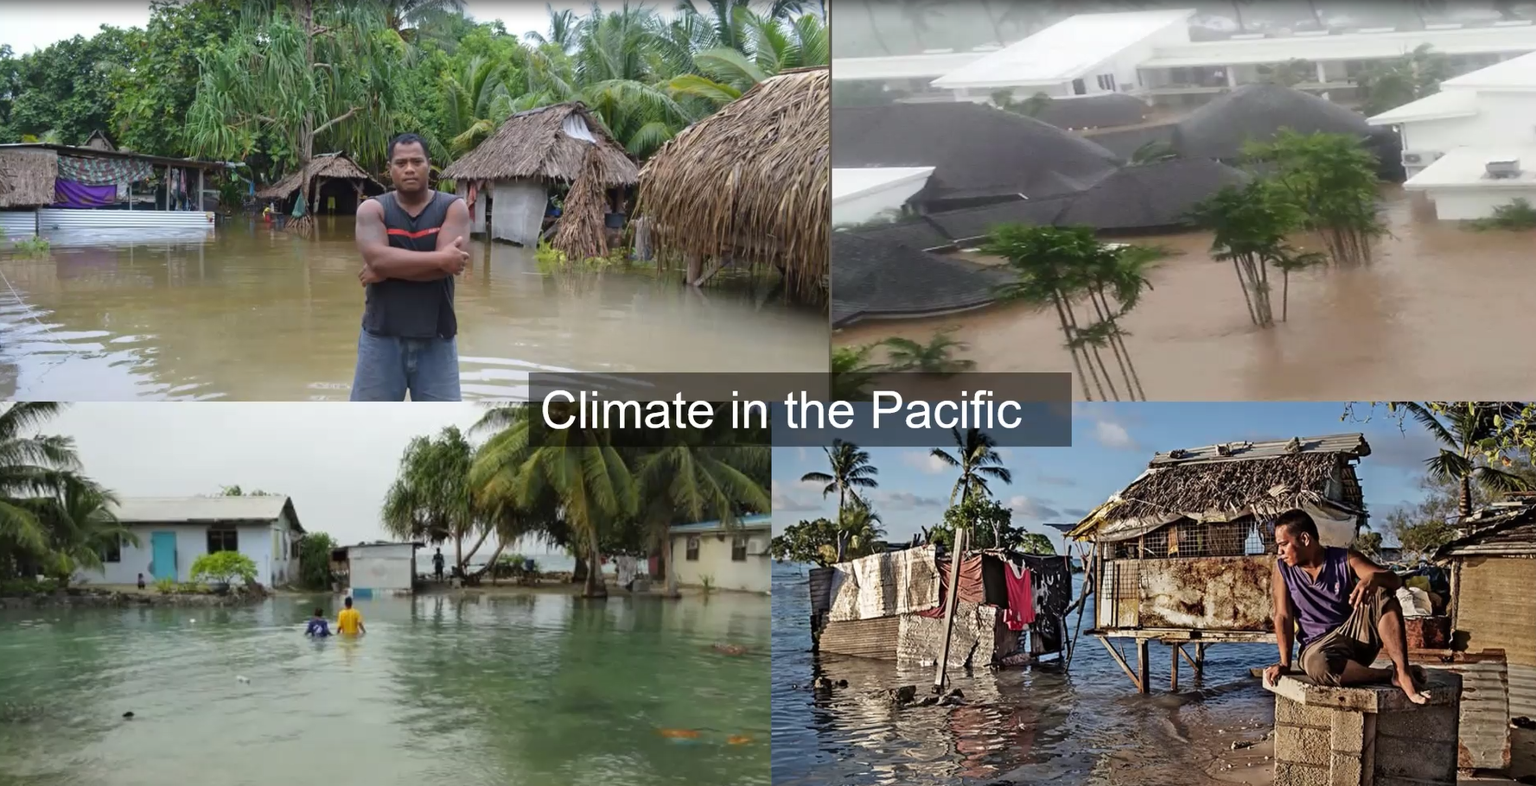
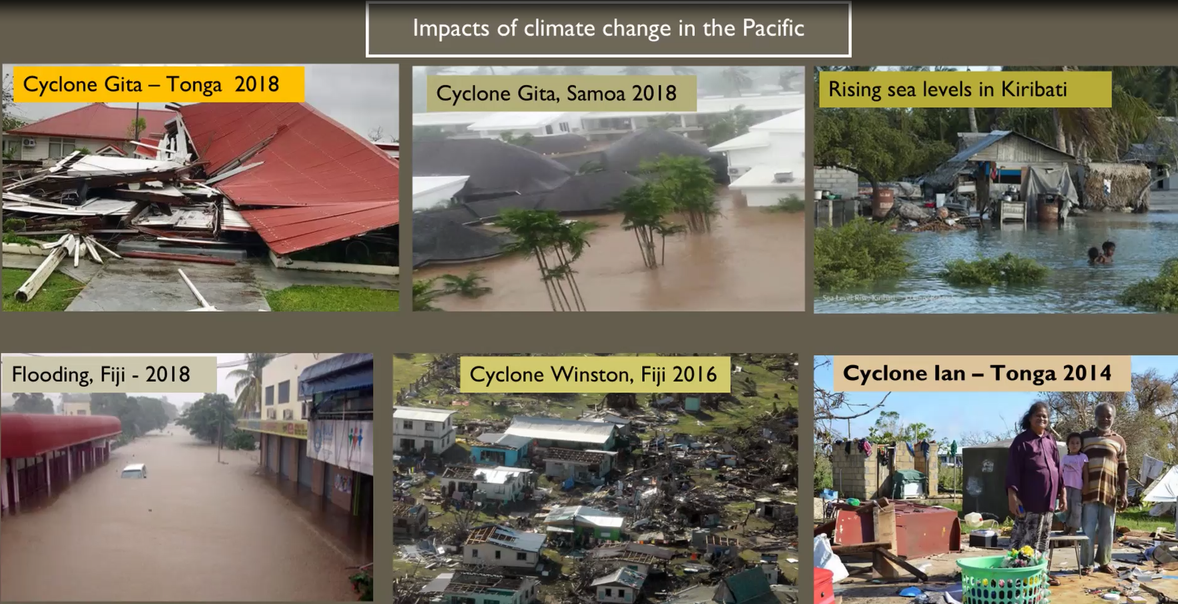
So who is my neighbour?
How do we respond to those impacted by climate change?

Slide 29
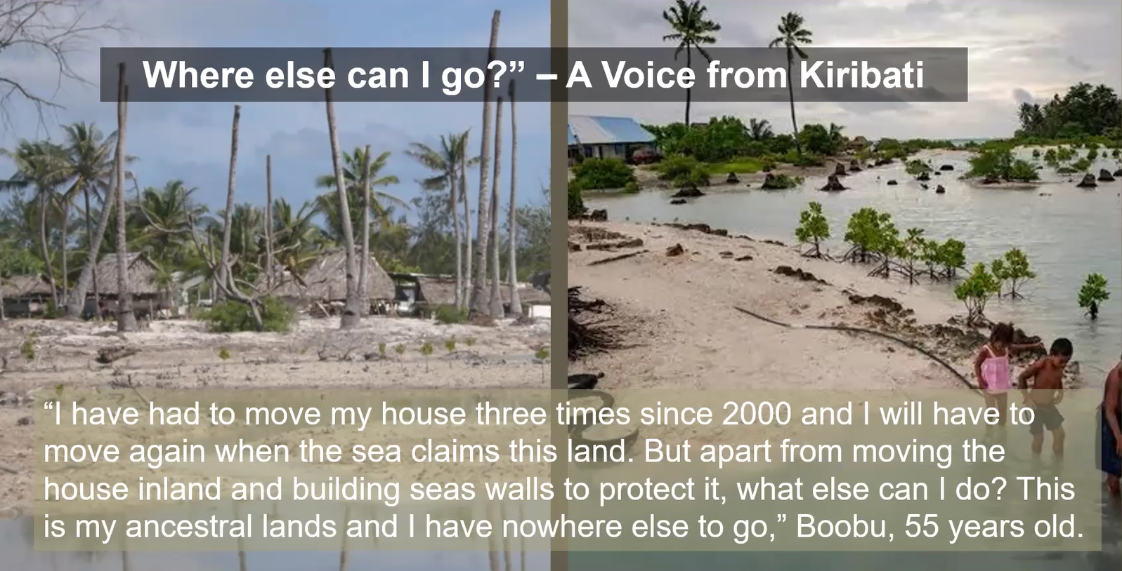

Slide 30
Watch a clip from the interview https://youtu.be/6W50_mZc0Hc

Slide 31
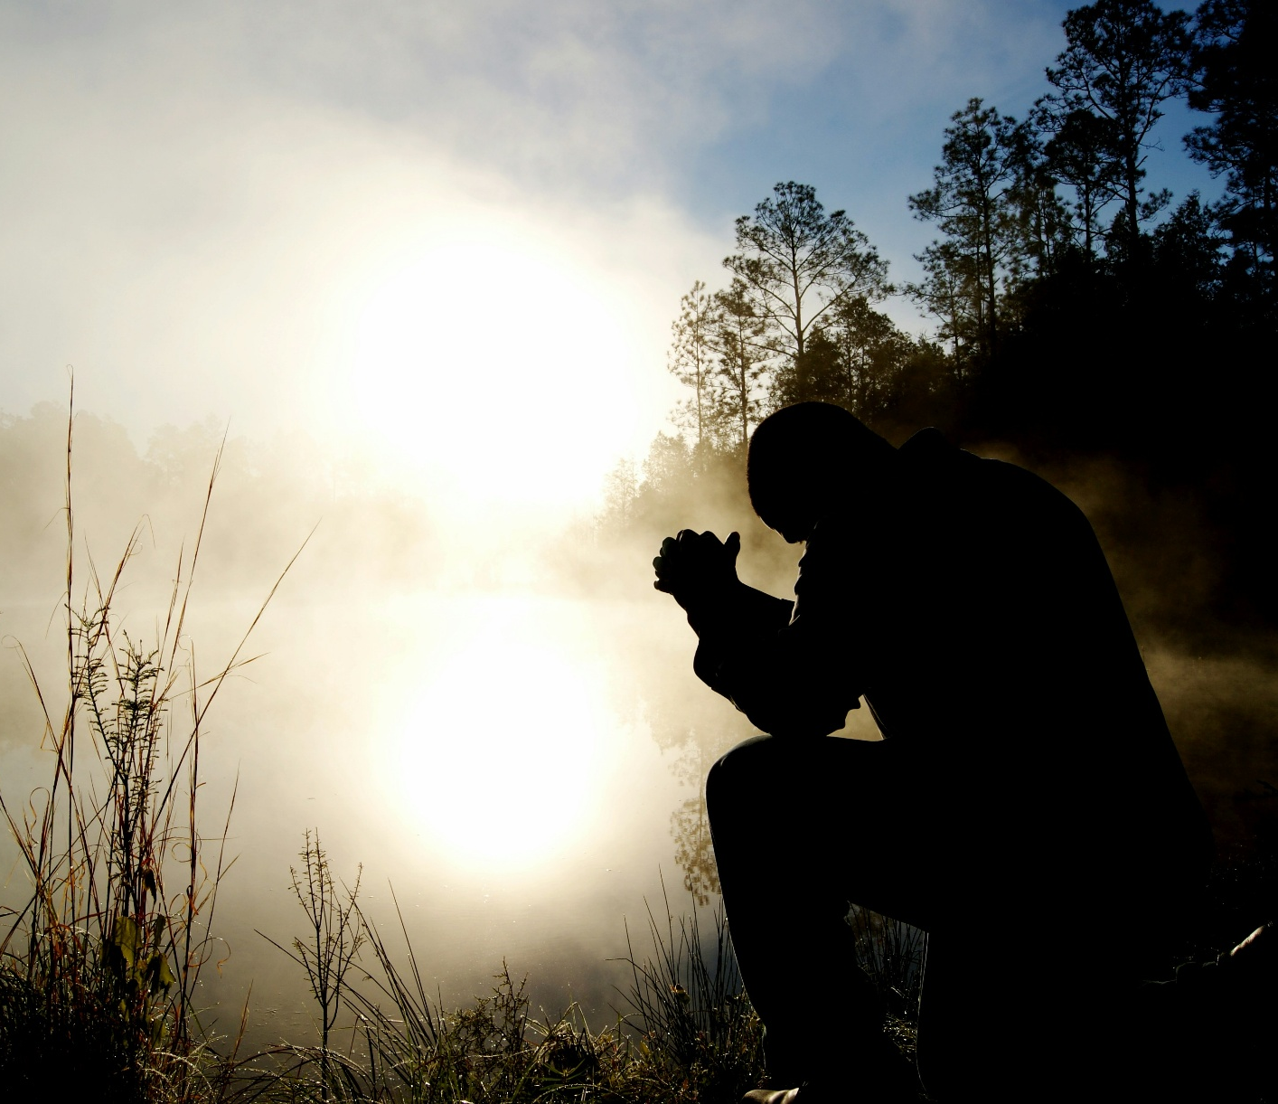
Prayer – an active response
Pray in solidarity
Prayer for God’s wisdom in our response
Remember Christ’s example
Photo by Aaron Burden on Unsplash

Slide 32
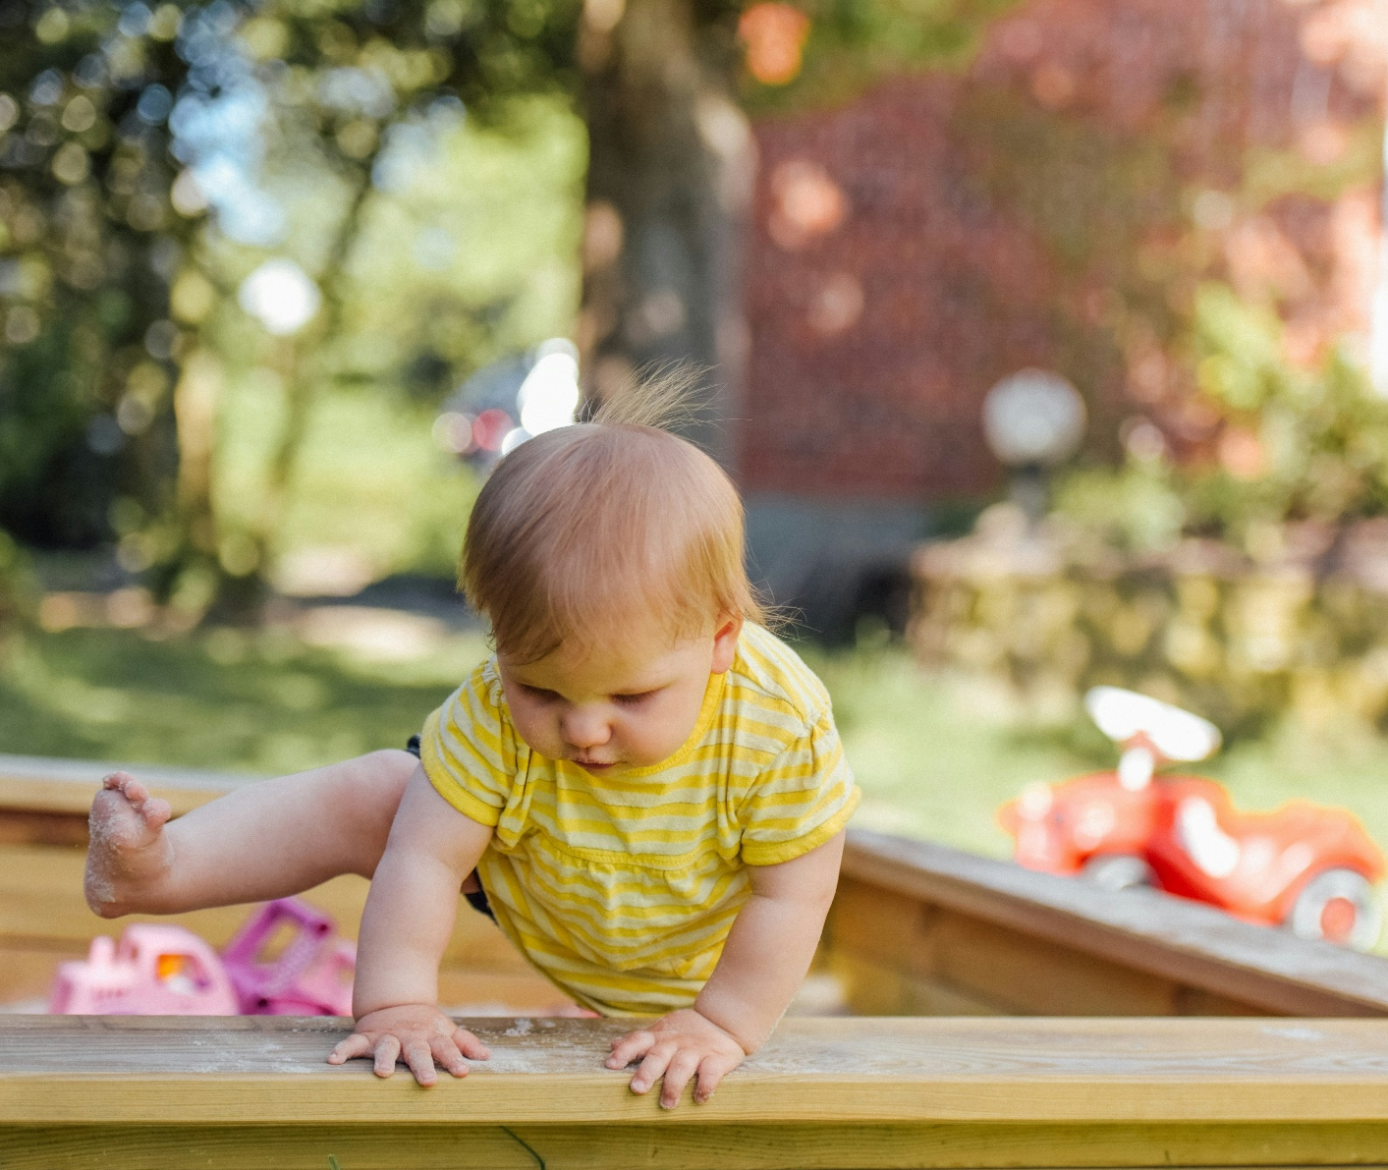
Go and do likewise - So what else can we do?
Ask Questions
Our Choices
Our Example
Our Influence
Photo by Alexander Dummer on Unsplash

