Slide 1
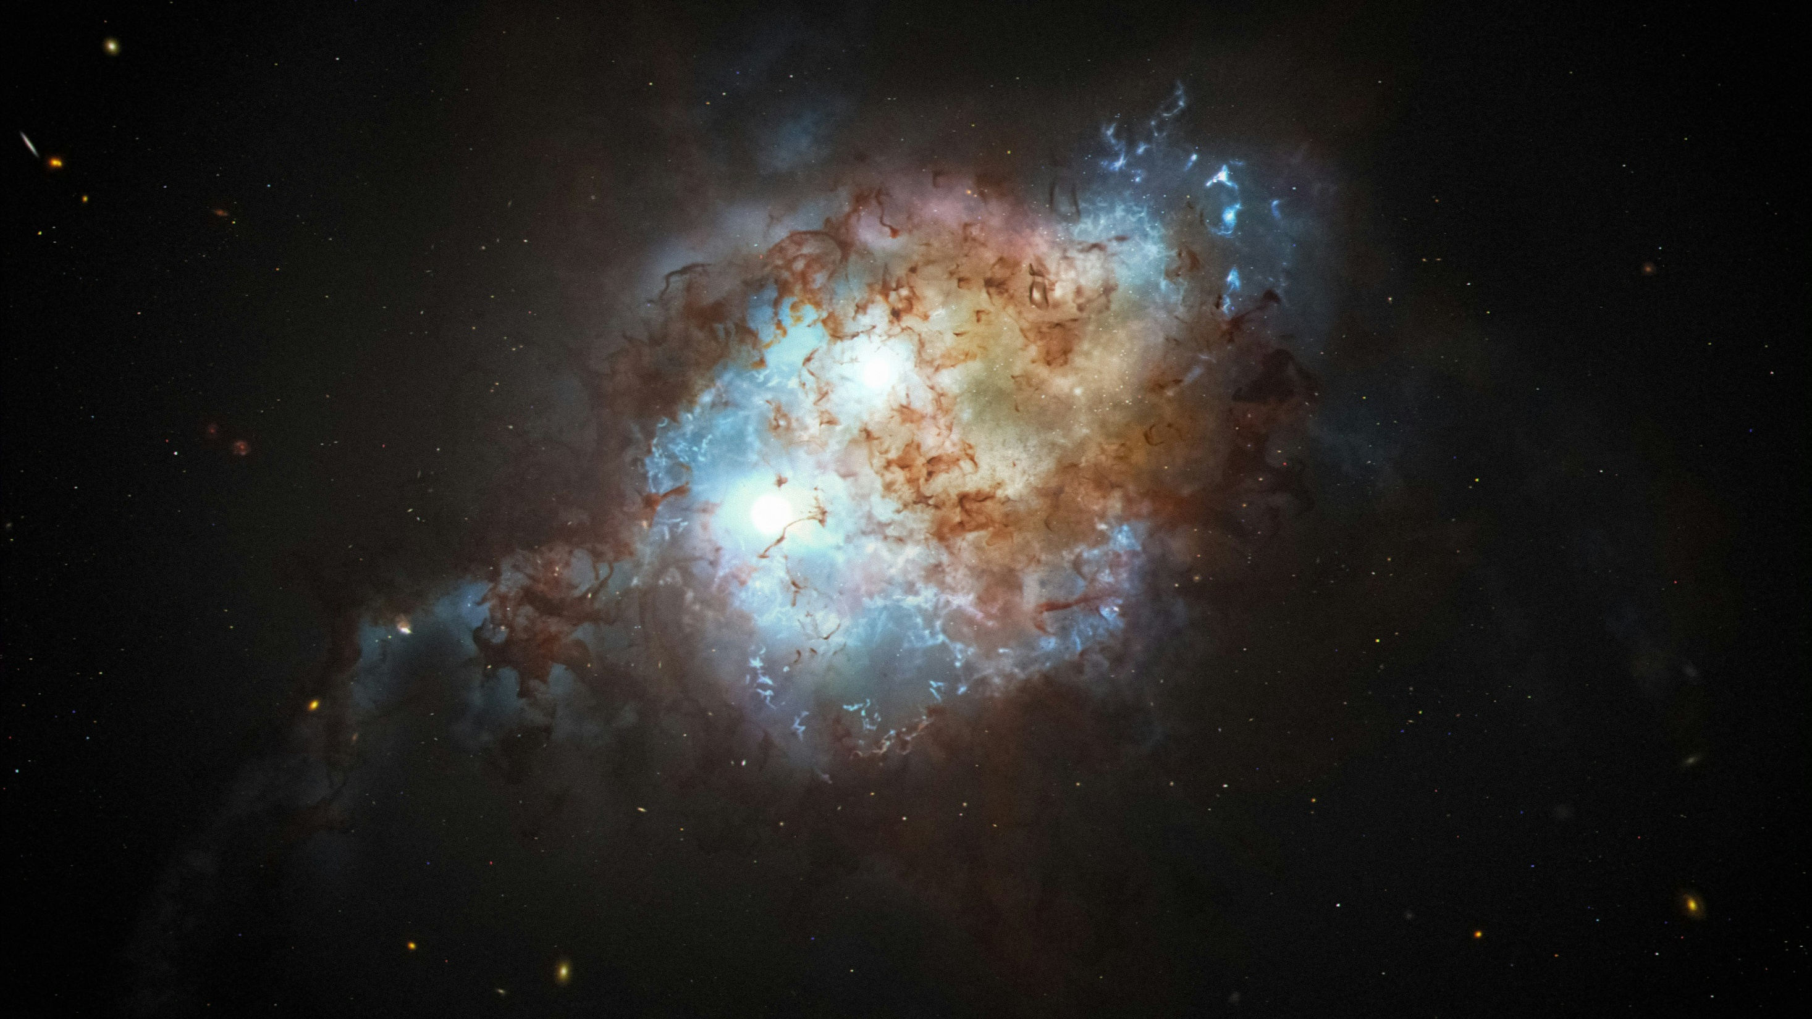
Photo by NASA Hubble Space Telescope on Unsplash
Notes:
In the ªbeginning, God creates the heavens and the earth, God creates light and sees that it is good and separates the light from the darkness.

Slide 2
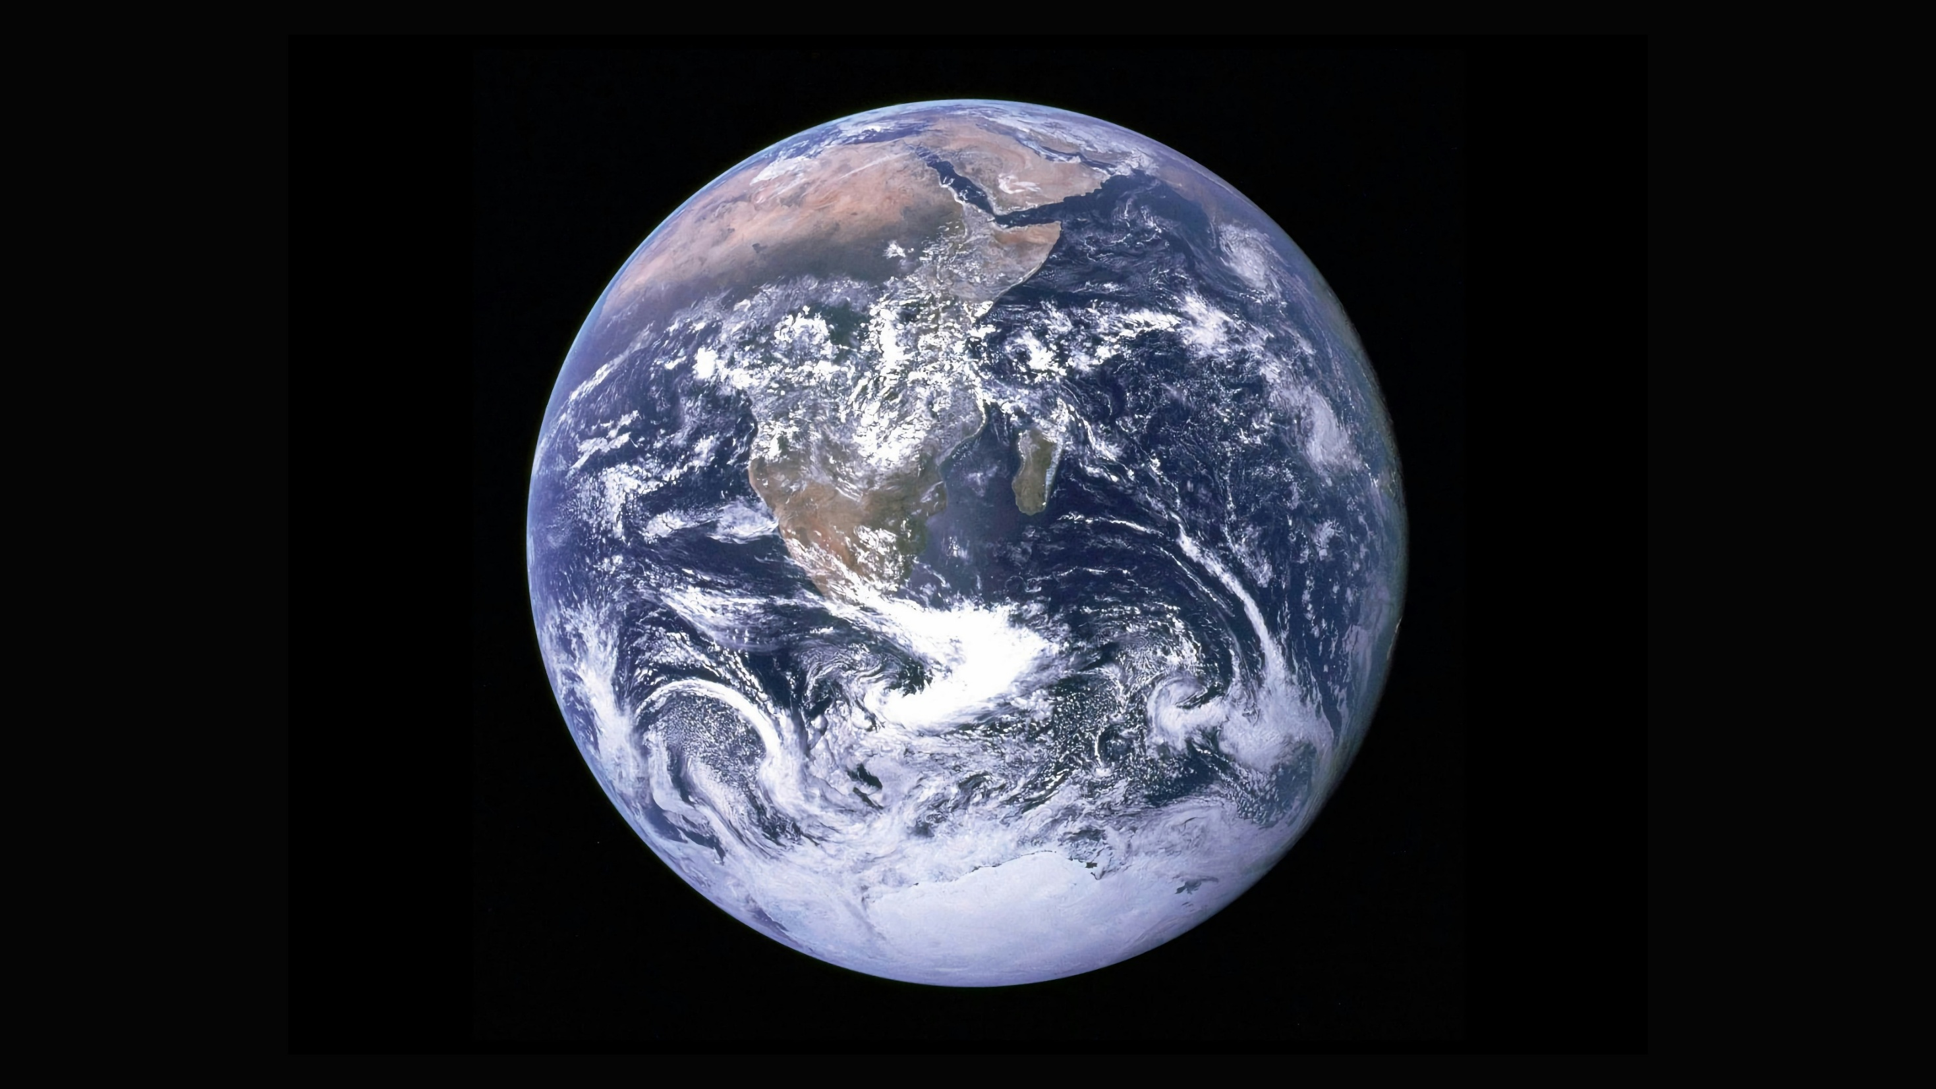
Photo by NASA on Unsplash
Notes:
Then God creates the planet earth and makes the dry land and the seas and the passage says that God saw that it was good.

Slide 3
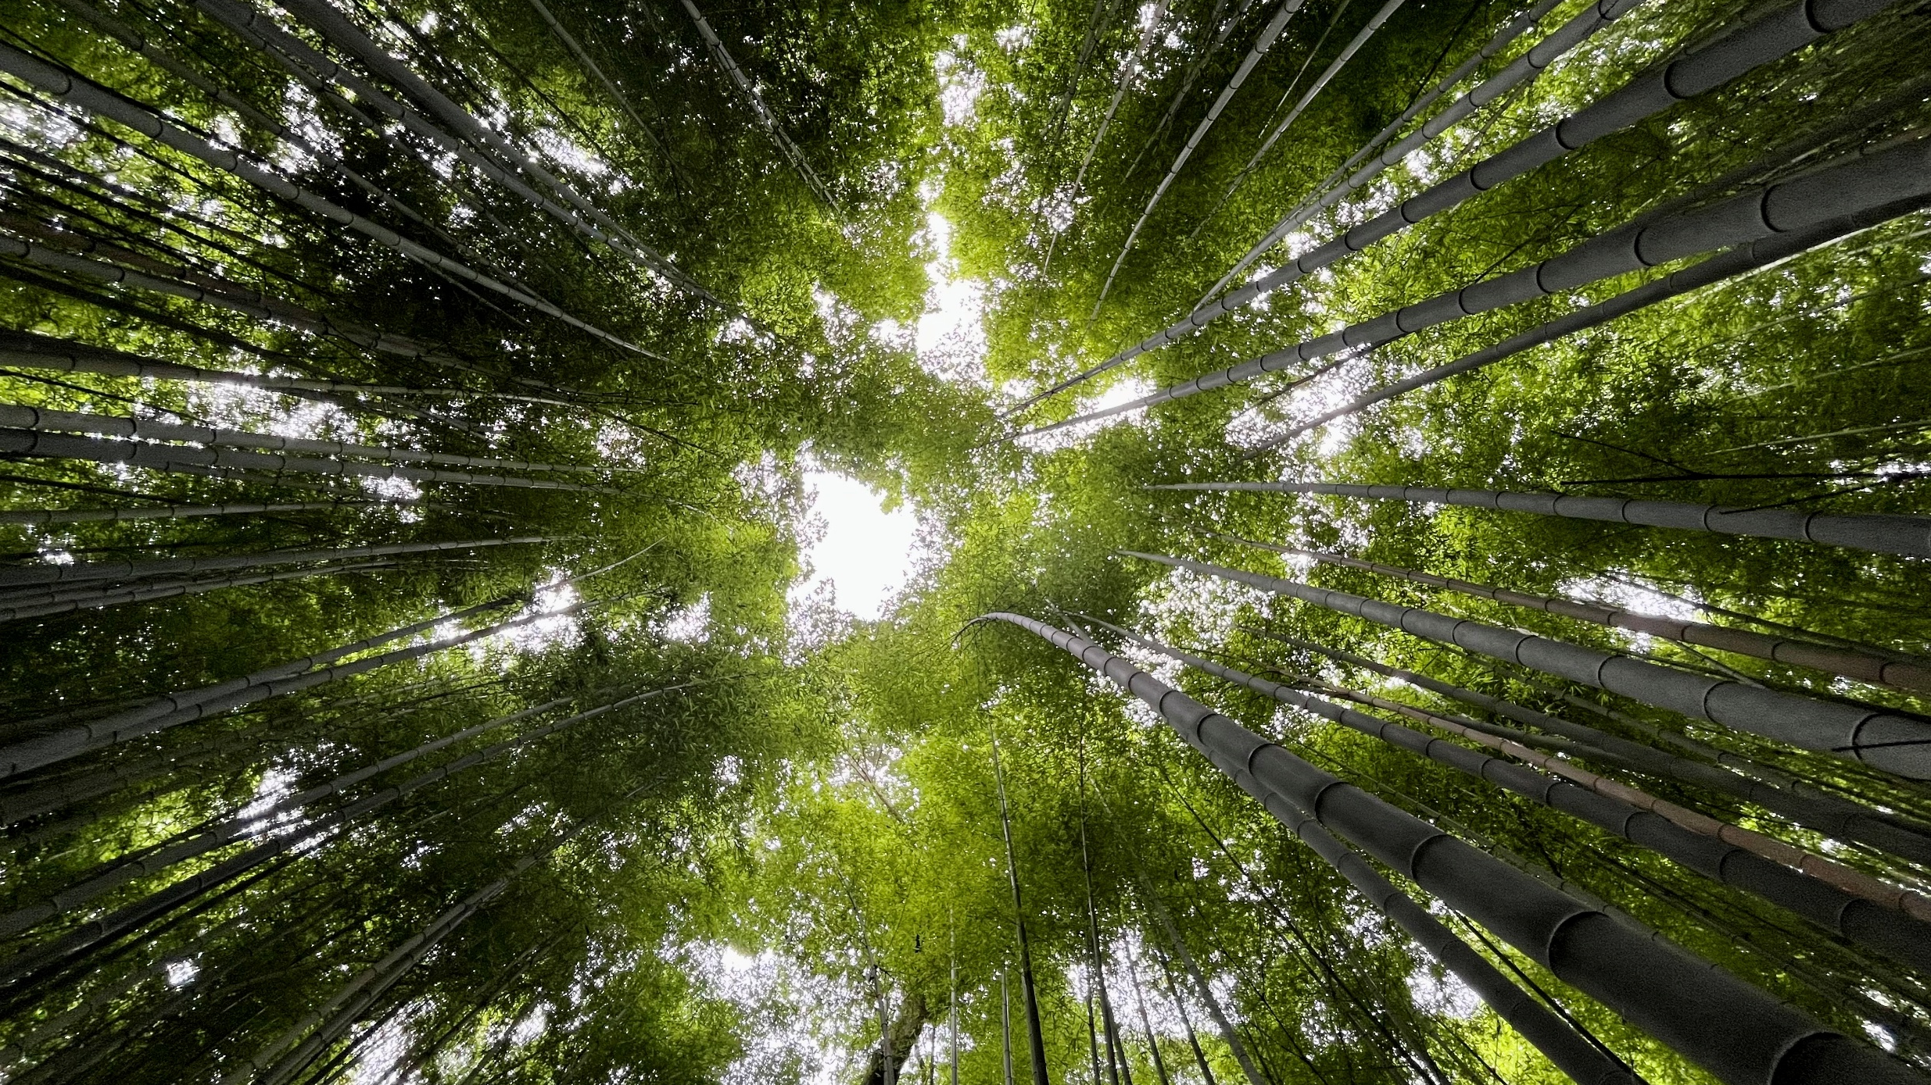
Notes:
Then God creates vegetation, plants⁵ yielding seed, and fruit trees bearing fruit. And again God sees that this is good.

Slide 4
How fast does bamboo grow?
10cm a day
45cm a day
90cm a day
Notes:
This is a bamboo forest in Japan – some bamboo can grow up to 30m in height – so how fast can bamboo grow ?
Hand up for 10cm a day, 45cm a day or 90cm a day??
In the right conditions bamboo has been known to grow 30cm in one hour – how amazing is that!

Slide 5
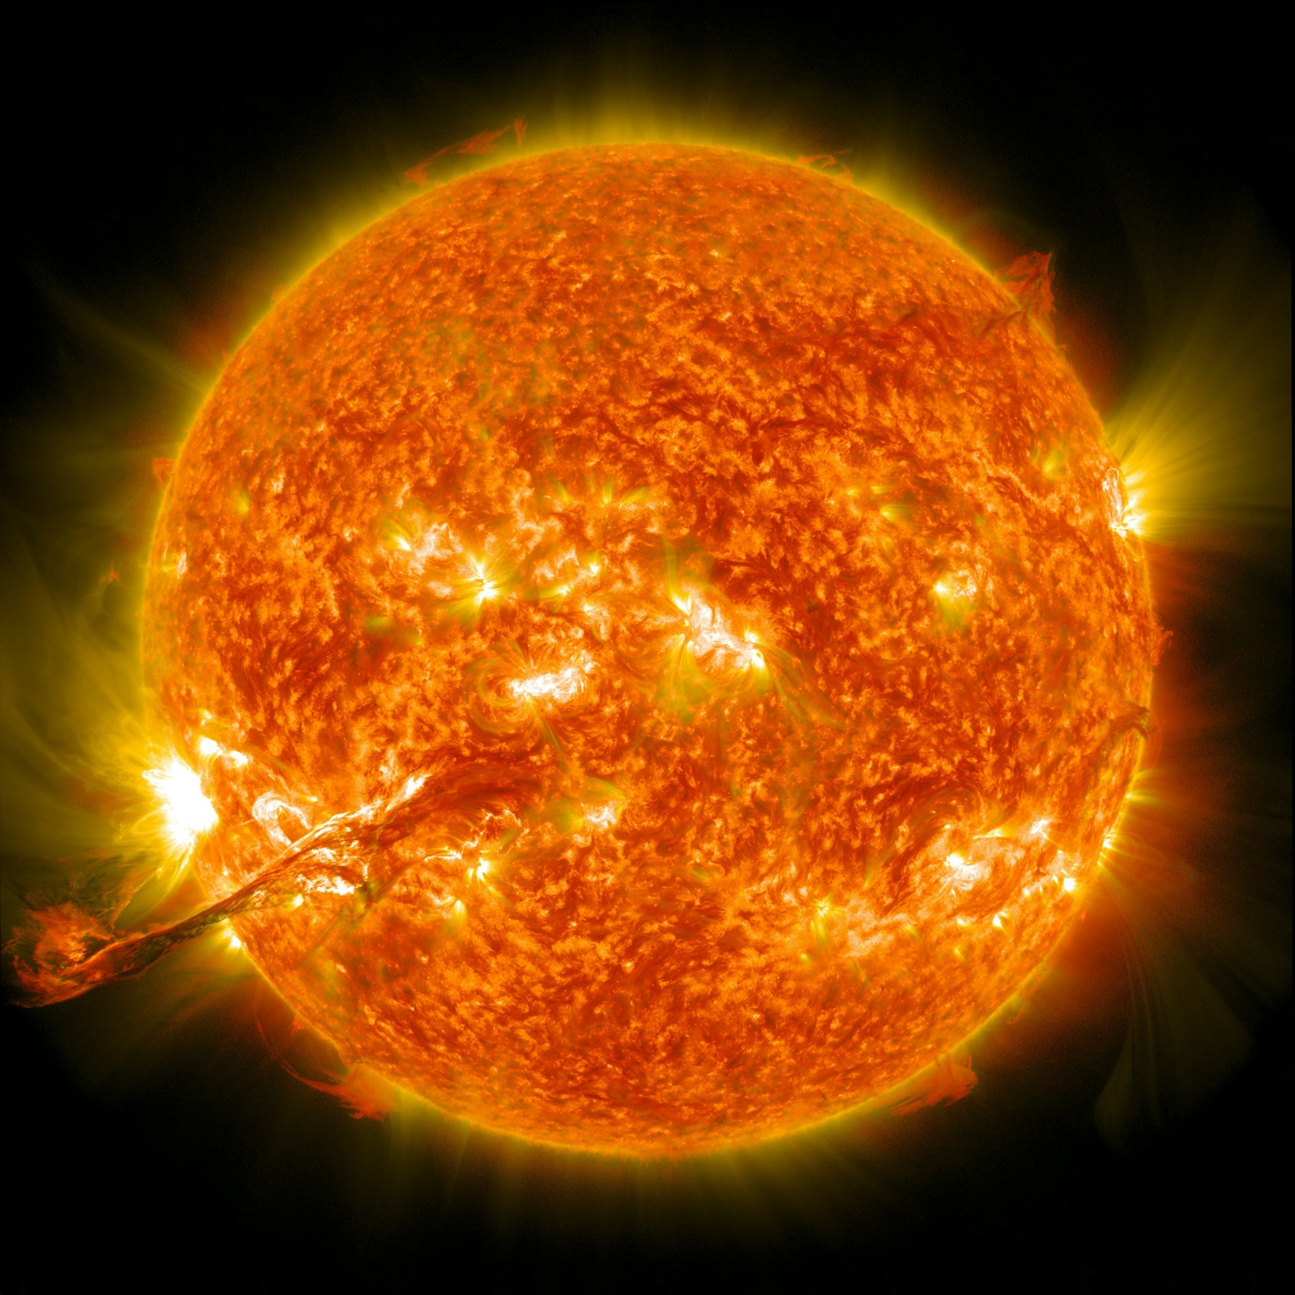
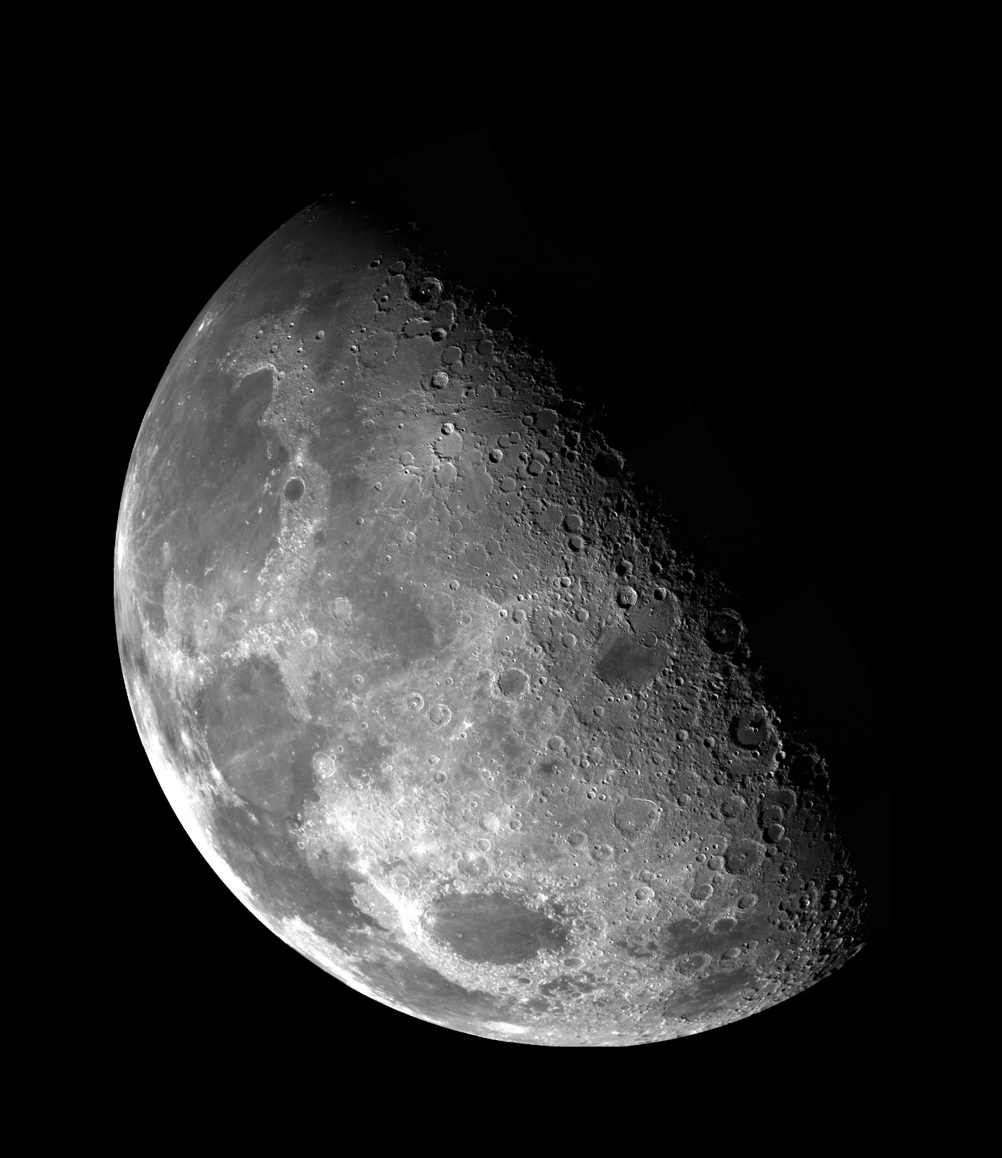
Photo by NASA on Unsplash
Notes:
Then God creates the sun and the moon and God sees that that is good.

Slide 6
How much bigger is the sun than the moon?
40x
400x
4000x
Photo by NASA on Unsplash
Notes:
400X

Slide 7
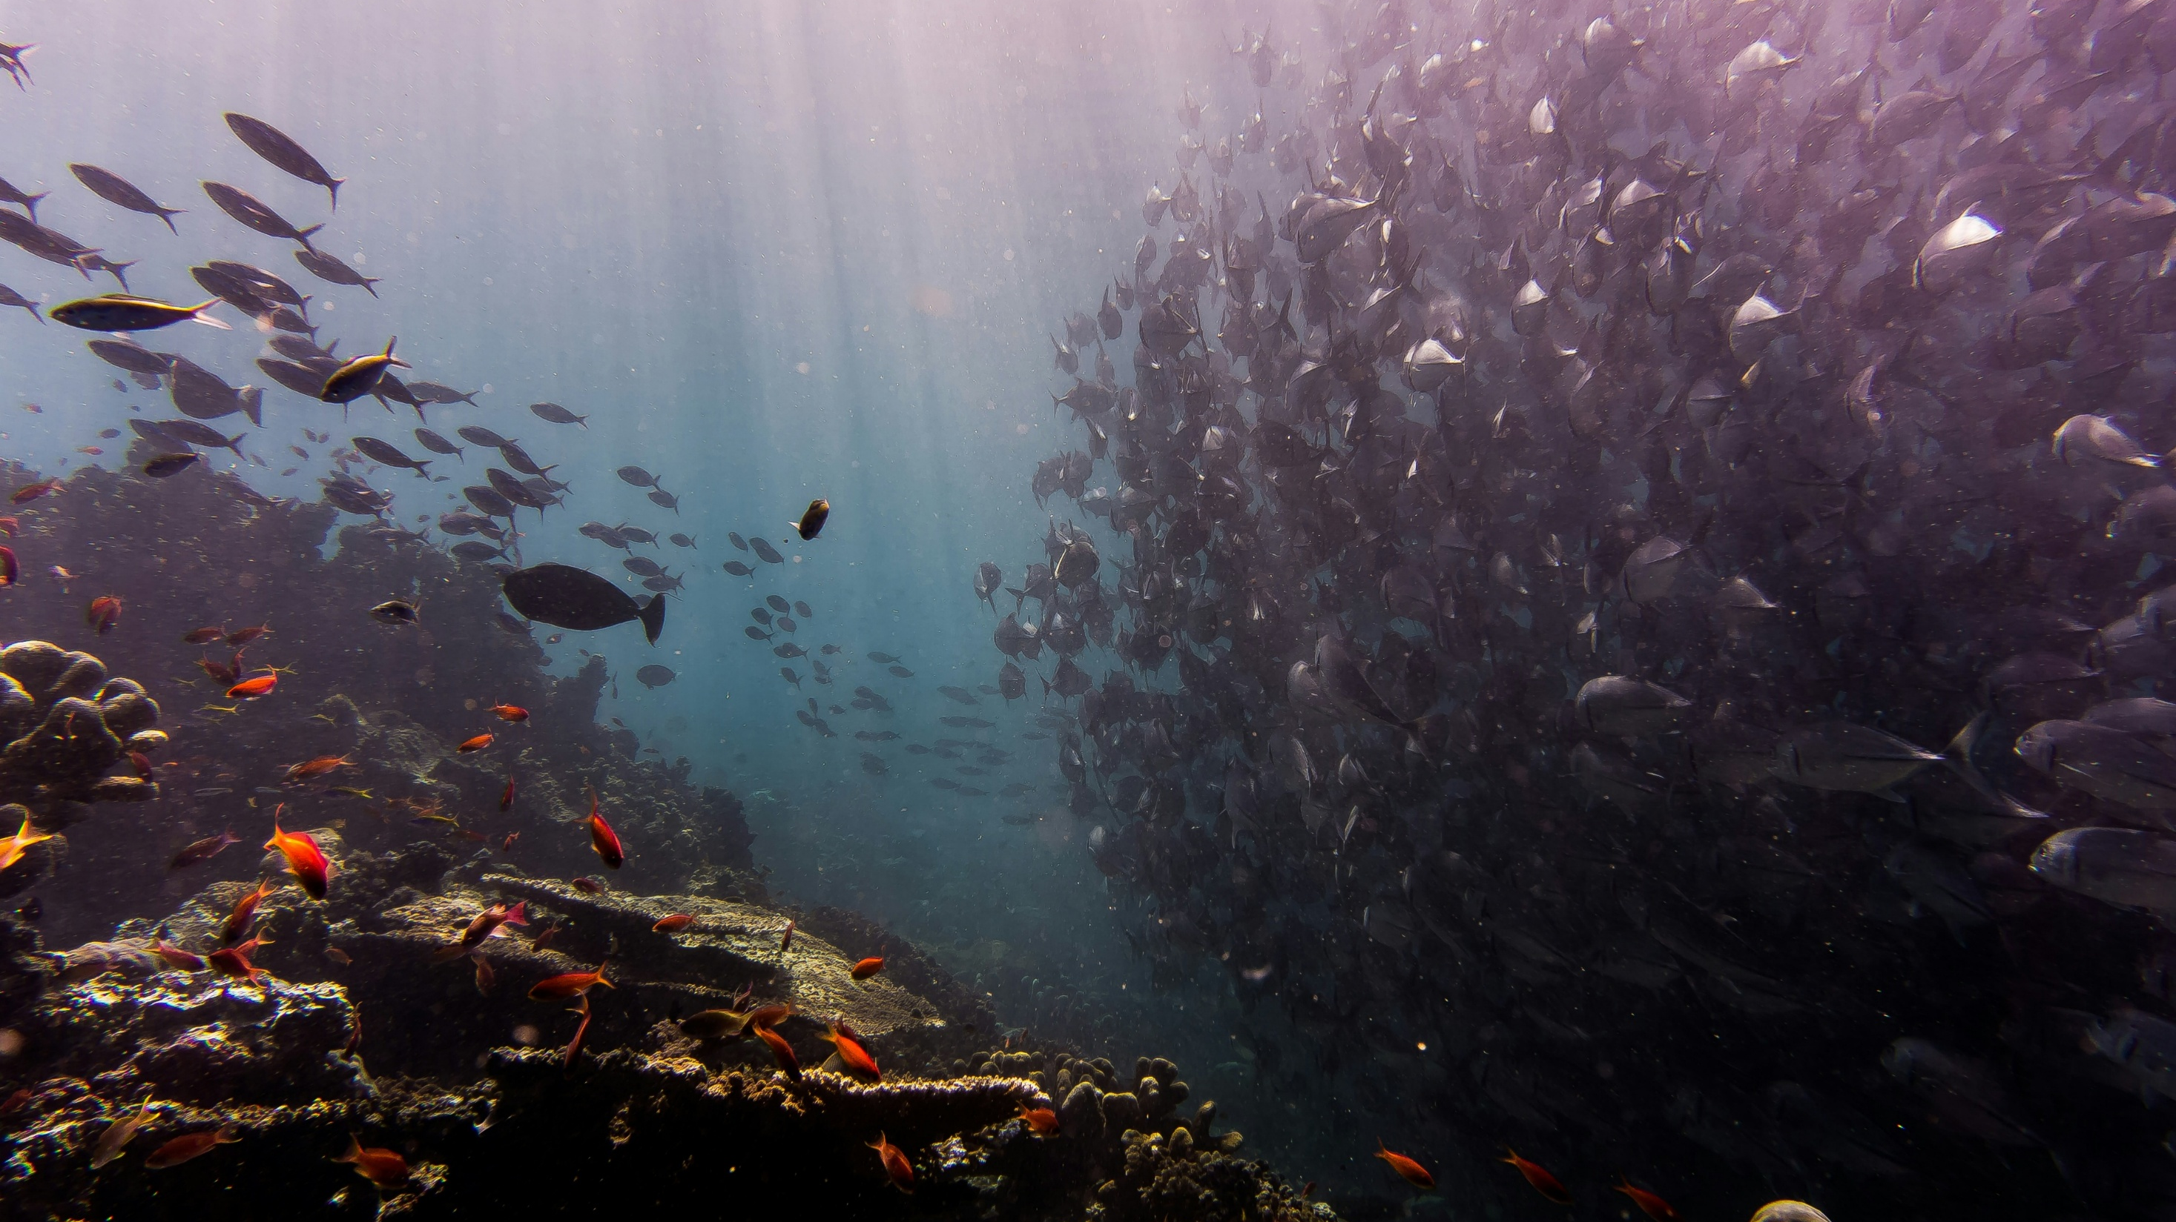
Notes:
Then things get really busy – God creates swarms of living creatures in the oceans

Slide 8
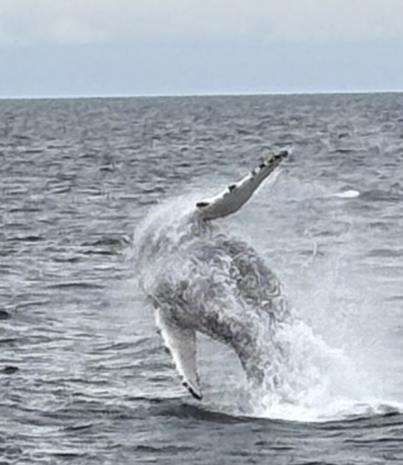
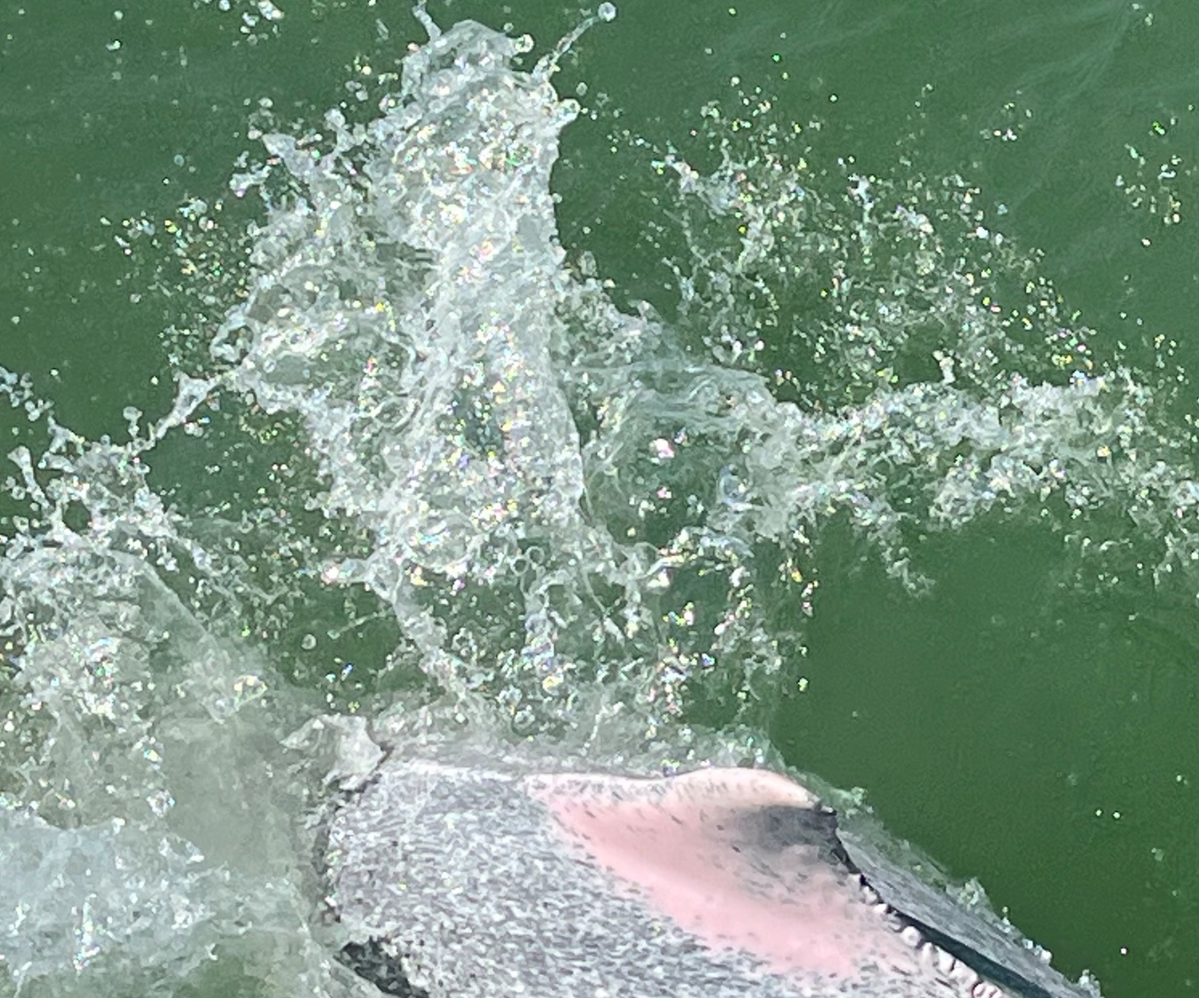
Notes:
And the great sea creatures and every living creature in the sea

Slide 9
Which eats more one humpback whale or 100 dolphins??
Notes:
On the left is a very happy humpback whale in Iceland and on the right is a pink dolphin from Hong Kong – so
Which eats more one humpback whale or 100 dolphins?
How much food can a humpback whale eat in a day
1.5tonnes (mainly krill)
Dolphin
14kg a day (octopus and fish)

Slide 10
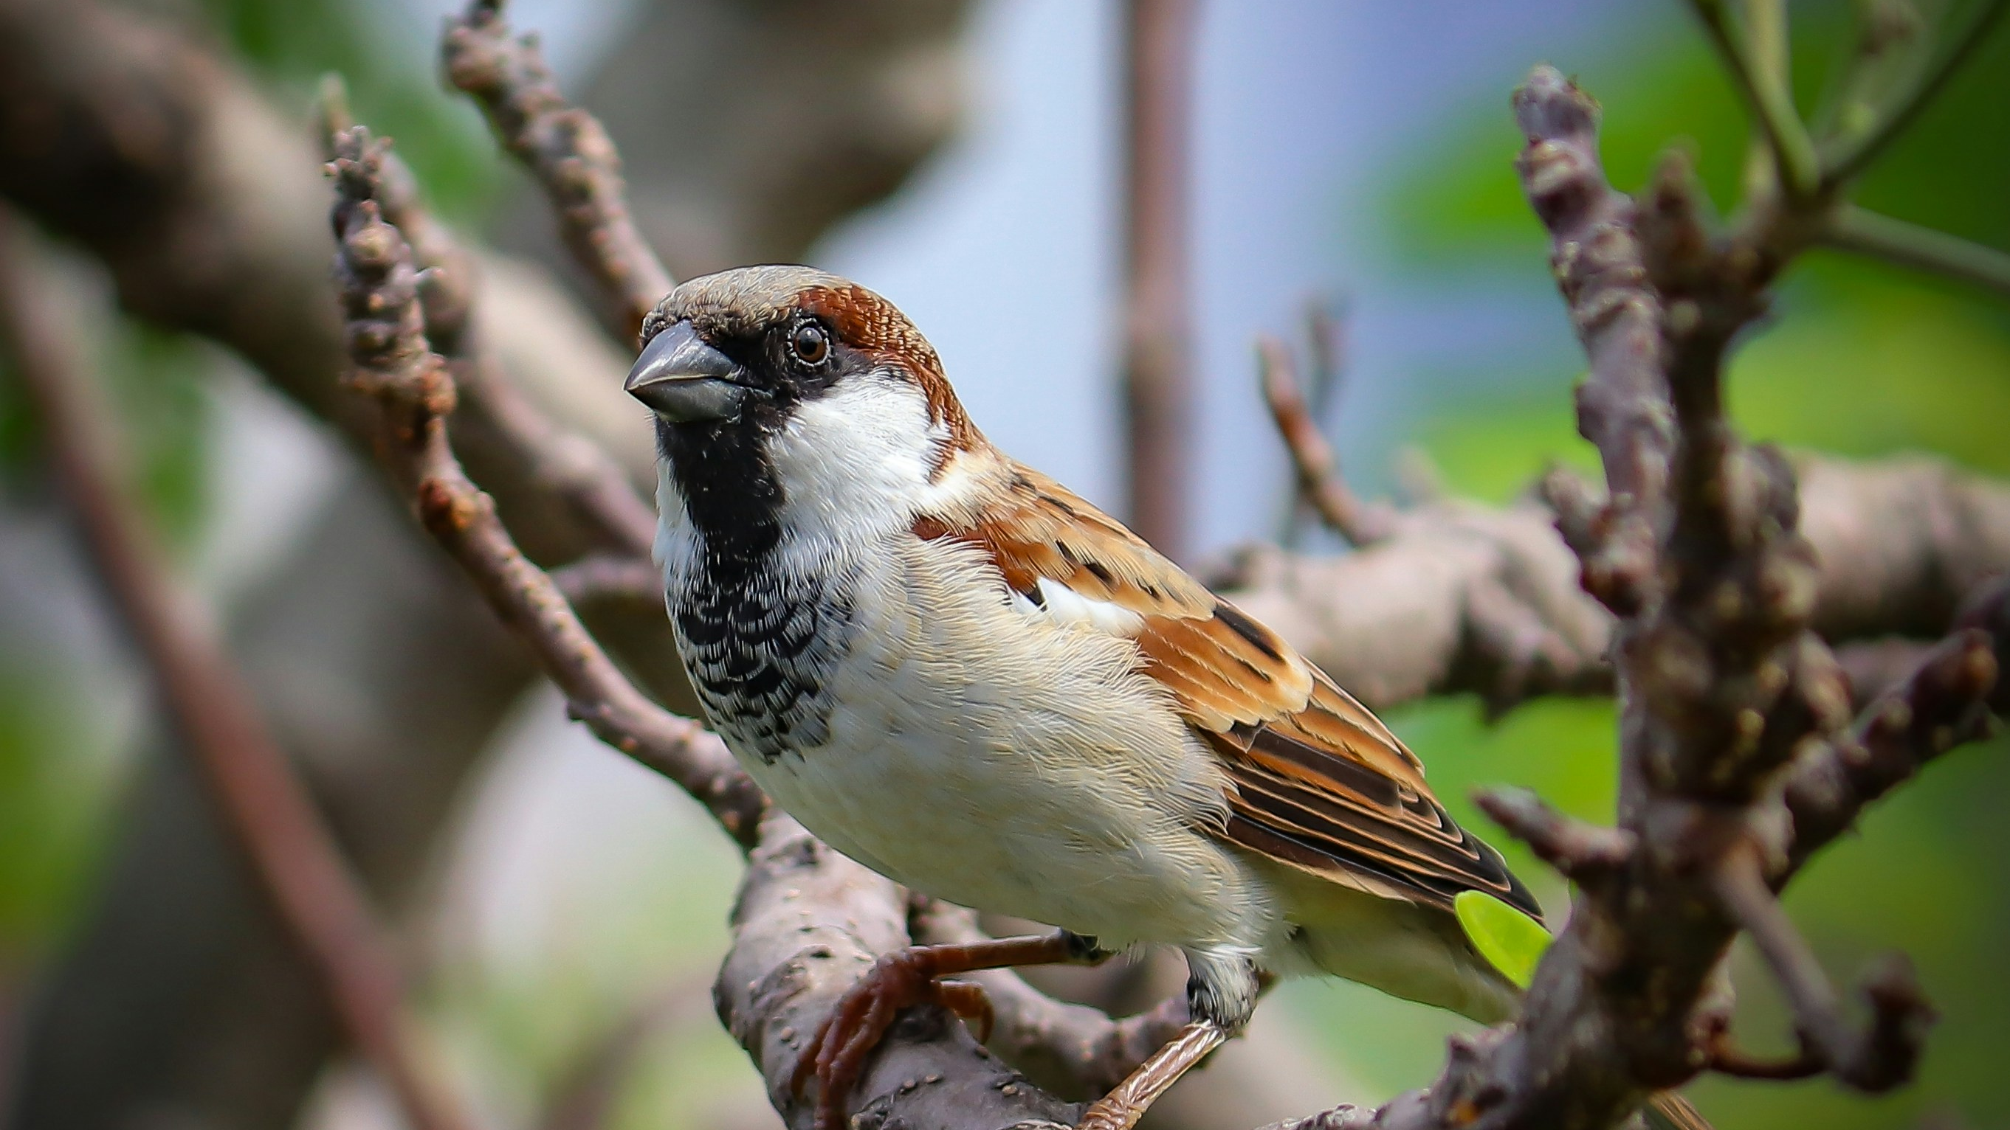
Photo by aniket solankar on Unsplash
Notes:
And he creates every bird and God sees this as good. And God blesses them to be fruitful and multiply.

Slide 11
How many sparrows today compared to 1970?
30,000,000 less
3,000,000 less
300,000 less
The same
Photo by aniket solankar on Unsplash
Notes:
So how many sparrows are the today compared to 1970?
30million less
Warning to look away for the next slide if you don’t like creepy crawlies!!

Slide 12
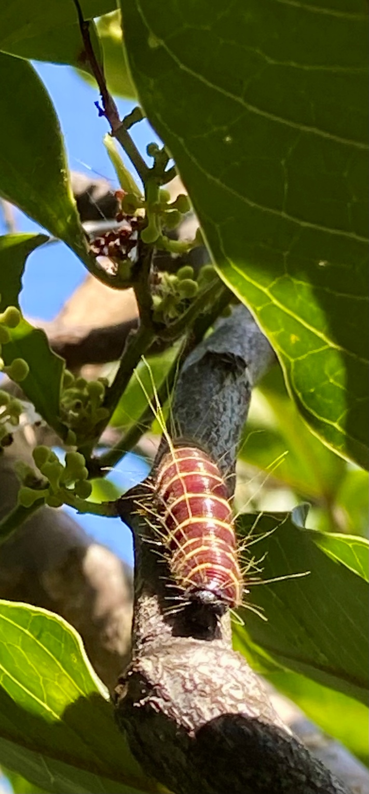
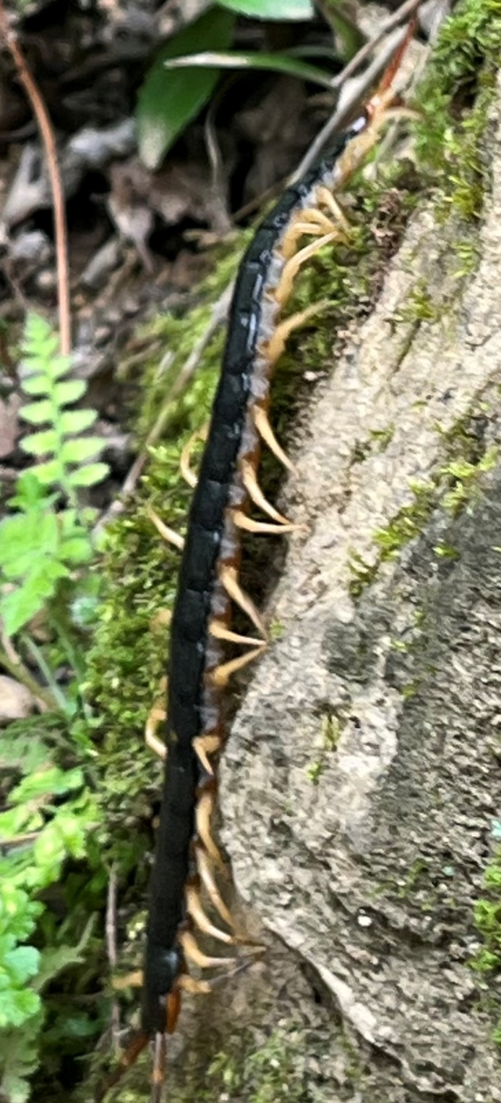
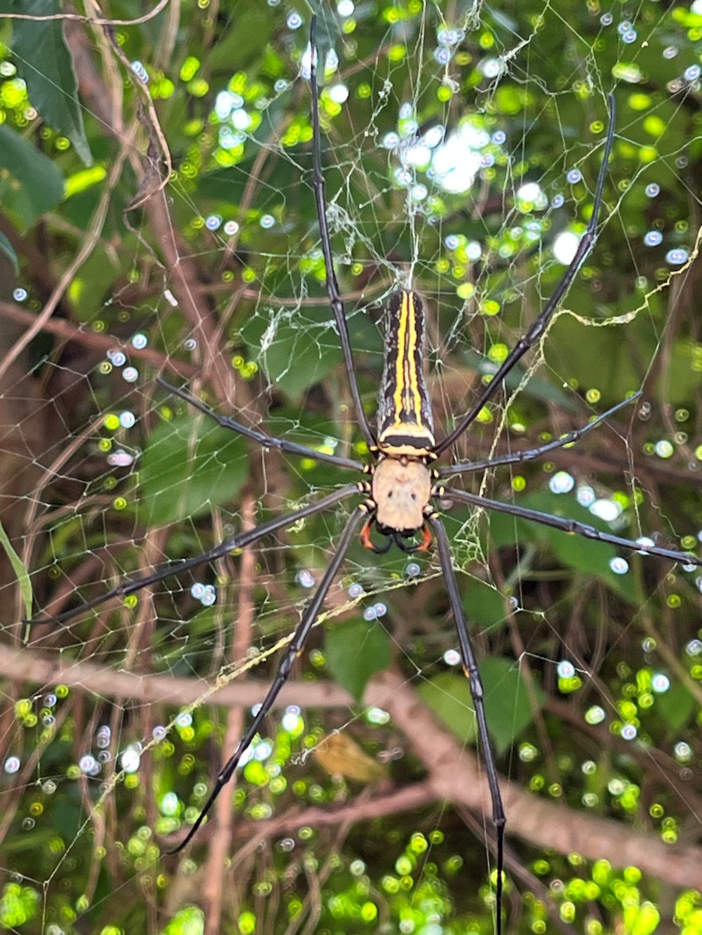
Notes:
Then God creates the living creatures on the earth including these ones that creep along the earth…..
Here’s some of the creepy ones…these God sees as good!

Slide 13
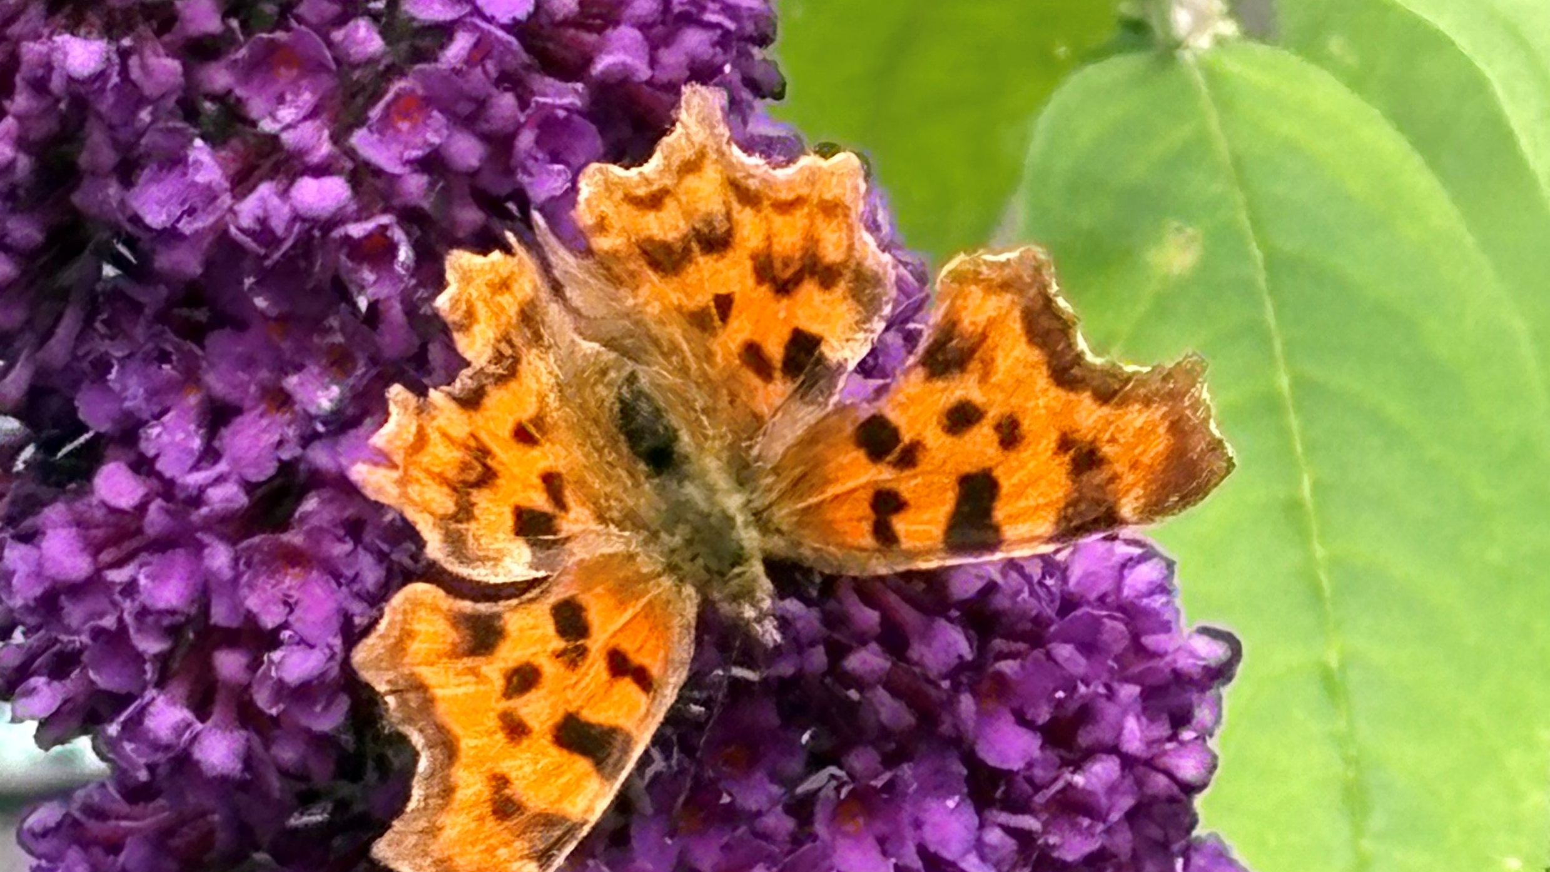
Notes:
Little less scarey - Safe to look back again!
This is a Comma butterfly from our garden in the summer

Slide 14
What does a butterfly taste with?
Eyes
Tongue
Feet
Notes:
What parts of butterflies do they taste with? Eyes, tongue or feet
Feet

Slide 15
Resources – small group
Photo by NASA Hubble Space Telescope on Unsplash
Notes:
In the ªbeginning, God creates the heavens and the earth, God creates light and sees that it is good and separates the light from the darkness.

Slide 16
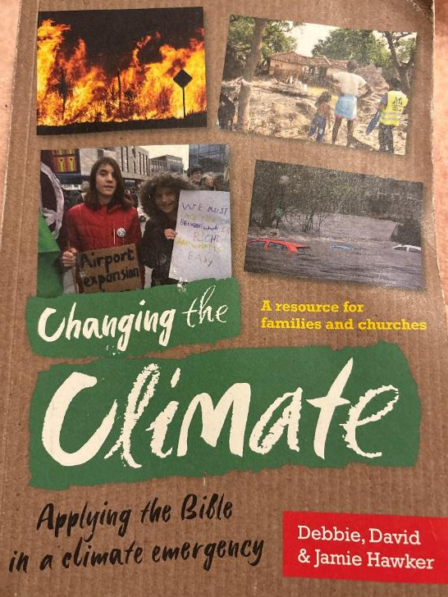
Useful references

Slide 17
Useful references
One of the 5 marks of Mission
“To strive to safeguard the integrity of creation and sustain and renew the life of the earth”

Slide 18
Resources – small group
Photo by NASA Hubble Space Telescope on Unsplash
Notes:
In the ªbeginning, God creates the heavens and the earth, God creates light and sees that it is good and separates the light from the darkness.

Slide 19
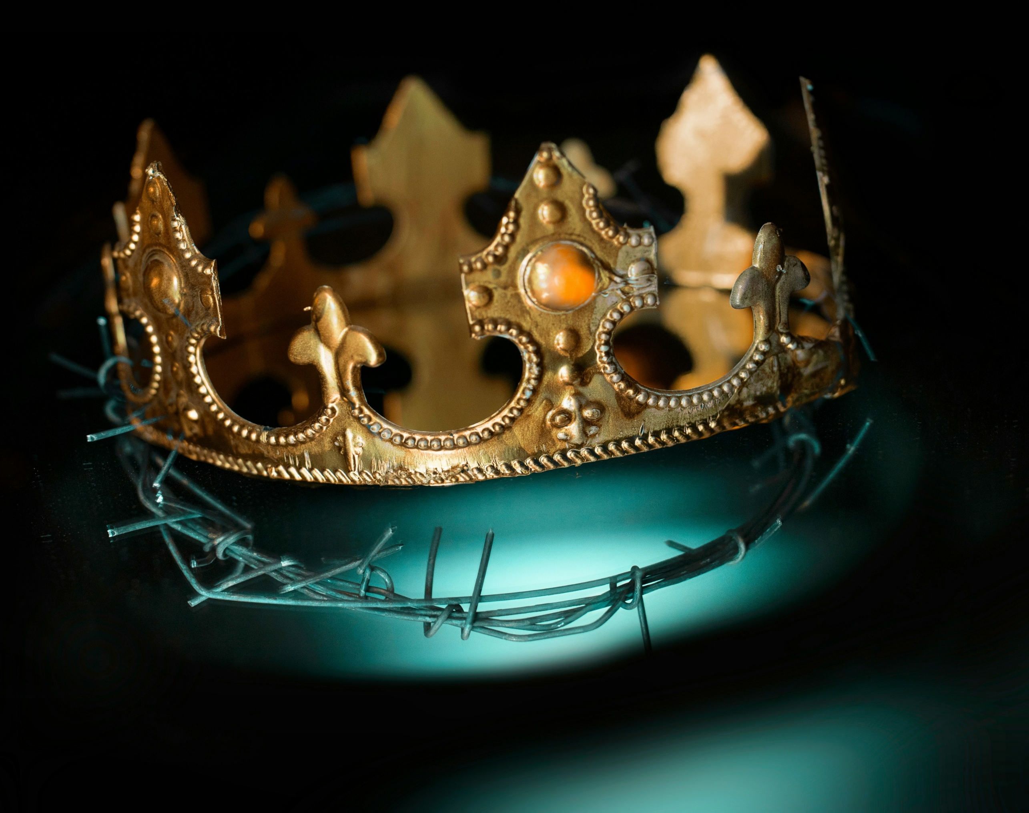
The subdue question
Photo by Carlos N. Cuatzo Meza on Unsplash

Slide 20
Notes:
Then God creates vegetation, plants⁵ yielding seed, and fruit trees bearing fruit. And again God sees that this is good.

Slide 21
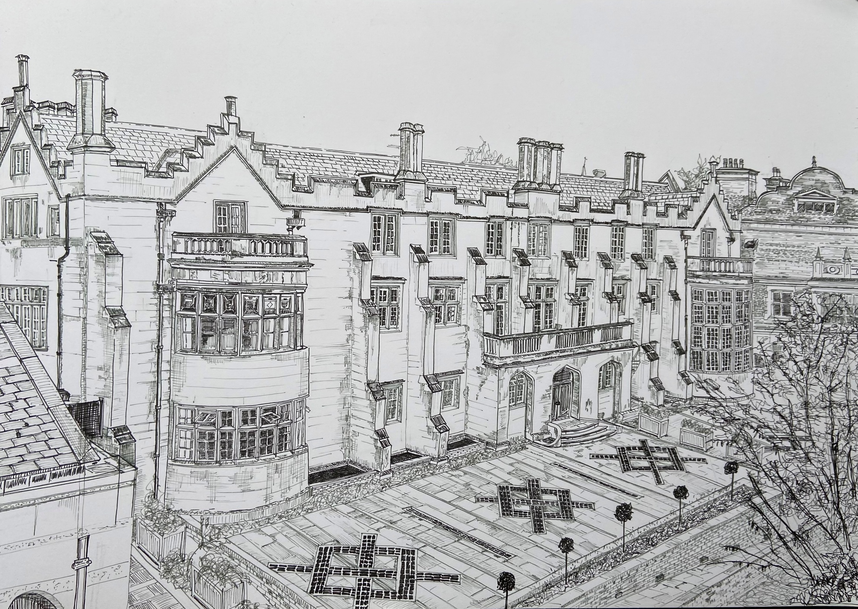
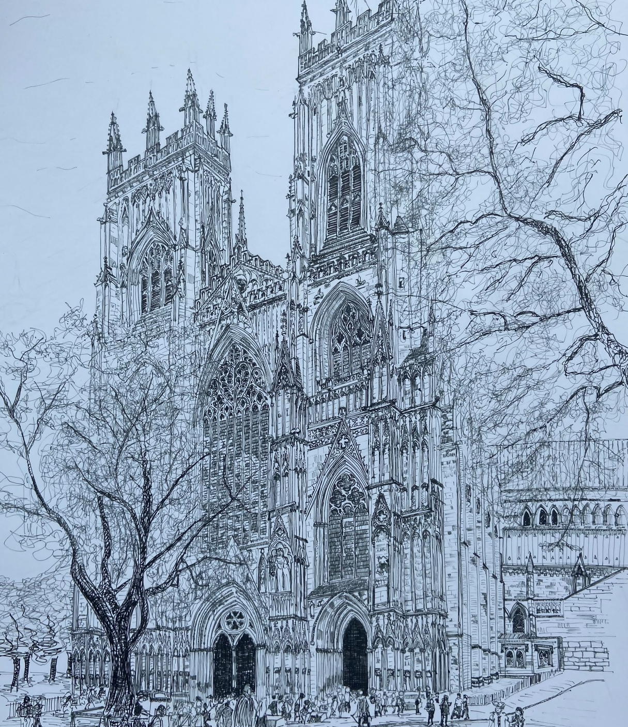
Respect for the Creator

Slide 22
Photo by NASA on Unsplash
Notes:
Then God creates the planet earth and makes the dry land and the seas and the passage says that God saw that it was good.

Slide 23
Photo by aniket solankar on Unsplash
Notes:
And he creates every bird and God sees this as good. And God blesses them to be fruitful and multiply.

Slide 24
The subdue question
Photo by Carlos N. Cuatzo Meza on Unsplash

Slide 25
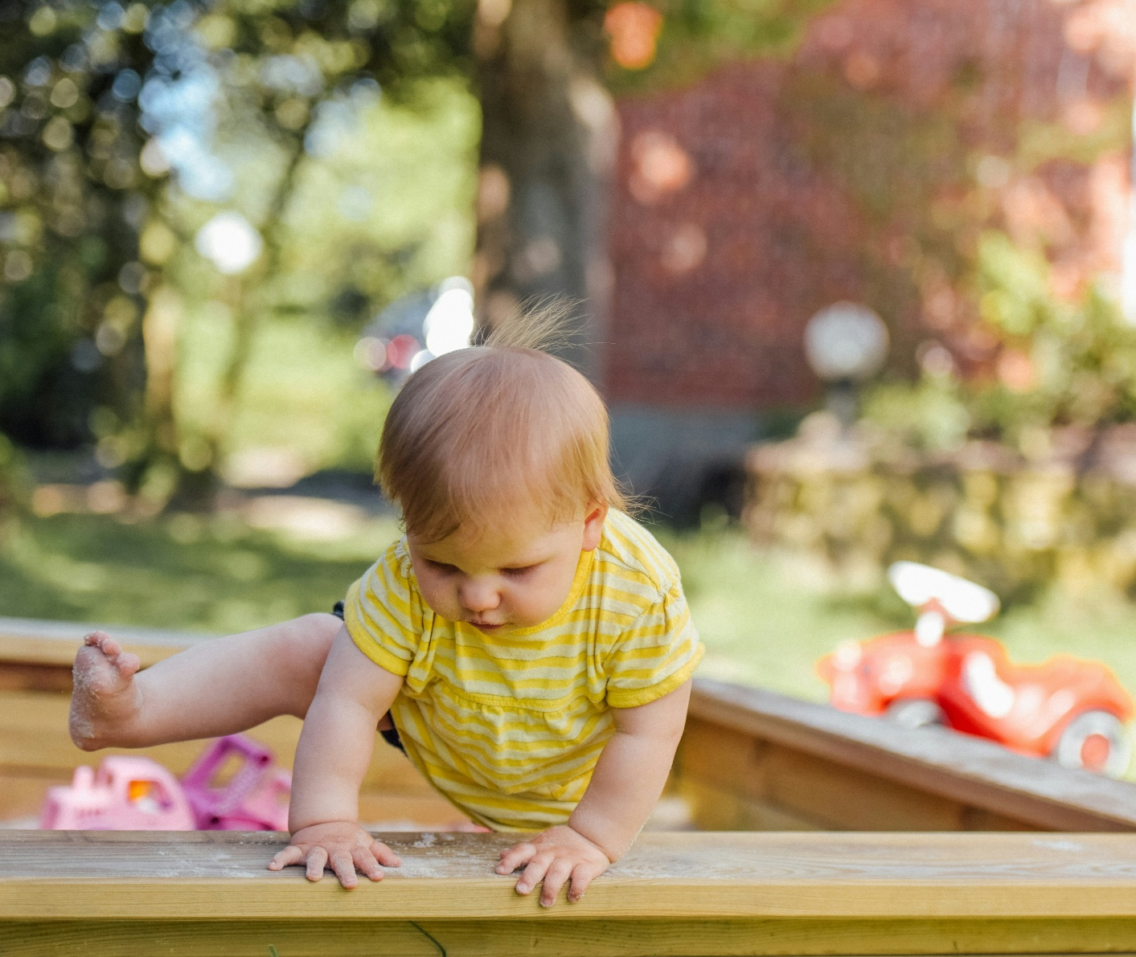
So what can we do - first steps
Ask Questions
Photo by Alexander Dummer on Unsplash

Slide 26
So what can we do - first steps
Ask Questions
Make informed choices
Photo by Alexander Dummer on Unsplash

Slide 27
So what can we do - first steps
Ask Questions
Make informed choices
Share impacts
Photo by Alexander Dummer on Unsplash

Slide 28
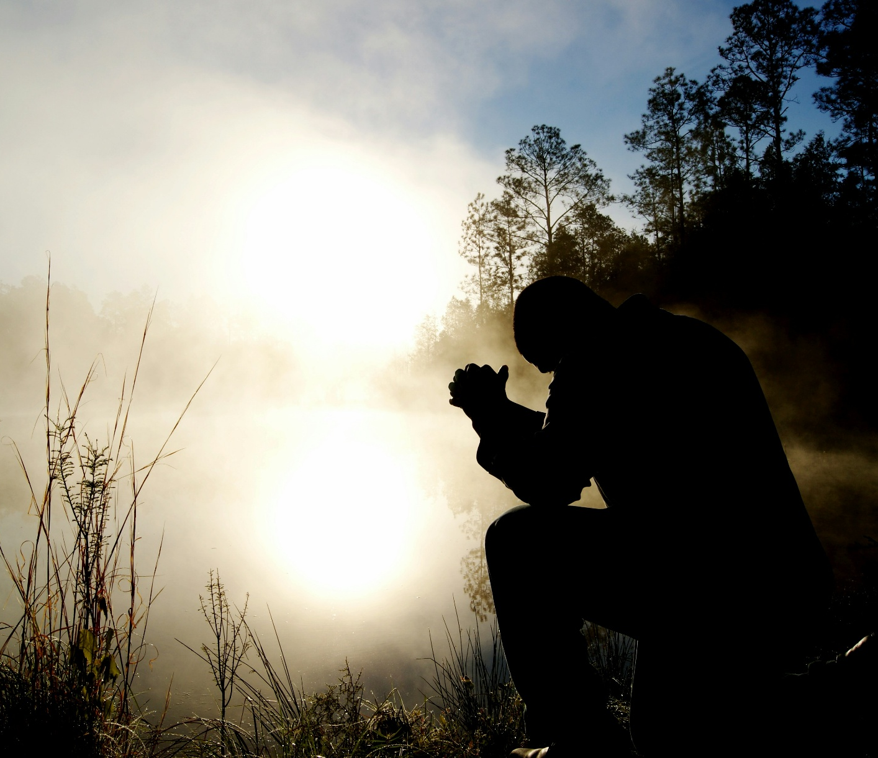
Act of witness
Pray for opportunity
Take a step in faith
Remember Christ’s example
Photo by Aaron Burden on Unsplash

Slide 29
Photo by NASA on Unsplash

