Slide 1
Safeguarding Basic Awareness
Aims and Outcomes
Edition 02. AUGUST 2021
Aims:
This course aims to provide learners with a basic awareness of safeguarding and enable them to integrate this into their Christian faith and the Church’s ministry.
On completion, participants will be able to:
Connect the core principles and practices of safeguarding to the Christian faith.
Recognise issues of power and abuse as they present themselves in a range of contexts, including the church.
Identify the barriers (emotional, psychological & theological) that can prevent the promotion of healthy church communities.
- Apply a clear process in the handling of concerns/safeguarding information whilst recognising the boundaries of their own role.
Introduction

Slide 2
Safeguarding Basic Awareness
Course Overview
1
2
3
4
5
Safeguarding
and the
Christian
faith
Safeguarding
Abuse
And
Grooming
Safeguarding
Scenarios
Responding
individually
and
collectively
Assessed
Scenario
Introduction

Slide 3
Safeguarding Basic Awareness
Advance Warning and Guidance
Warning : This course may
provoke strong feelings,
reactions or concerns...
Make use of
help and
support
Report any
concerns
you may have
Take a break if you need to
Introduction

Slide 4
Safeguarding Basic Awareness
Safeguarding and the Christian faith
https://youtu.be/6ShAoncWoyY
Part 1 - Safeguarding and the Christian Faith

Slide 5
Safeguarding Basic Awareness
Recognising our responsibility
Survivors
"As a survivor I need to see the church understand what happened, to remember it correctly, to discern where responsibilities lay, and to integrate it into their history. It is a really brave church community that decides to face such abuse head-on.”
The vulnerable
"The Church is intended to be a place where men, women and children, including those who are vulnerable, find healing and wholeness."
( Protecting All God’s Children, 2010 )
Part 1 - Safeguarding and the Christian Faith

Slide 6
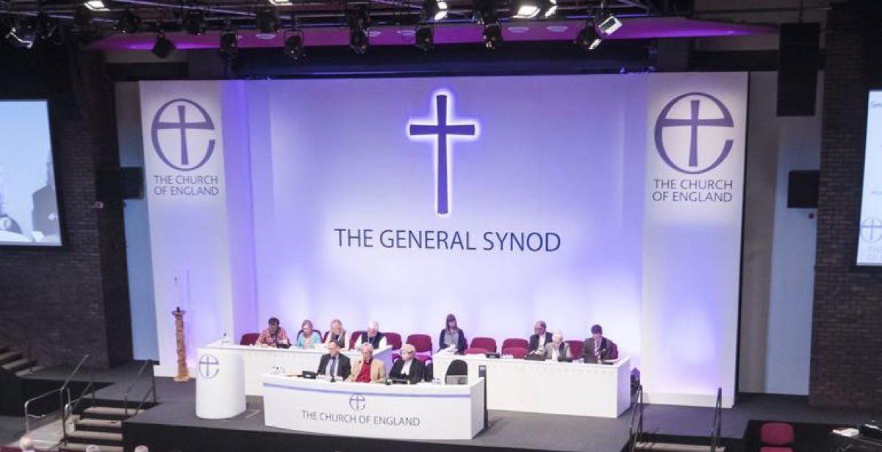
Safeguarding Basic Awareness
The Church of England’s response
1st Child Protection Policy 1997
Diocesan Safeguarding Advisors
Diocesan Safeguarding Teams
National Training Framework
https://www.churchofengland.org/more/safeguarding
Part 1 - Safeguarding and the Christian Faith

Slide 7
Safeguarding Basic Awareness
Promoting a safer church
6 overarching commitments
Promoting a safe environment and culture.
Safely recruiting and supporting all those with safeguarding responsibilities.
Responding promptly to every safeguarding concern or allegation.
Caring pastorally for victims/ survivors of abuse.
Caring pastorally for those who are the subject of concerns or allegations of abuse.
Responding to those that may present a risk to others.
Part 1 - Safeguarding and the Christian Faith

Slide 8
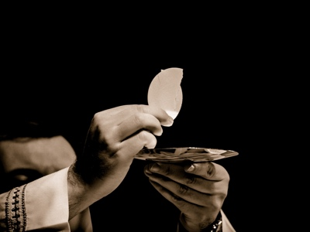
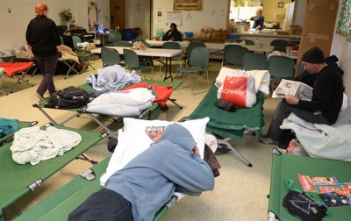
Safeguarding Basic Awareness
Where do I fit in?
Part 1 - Safeguarding and the Christian Faith

Slide 9
Safeguarding Basic Awareness
Review your learning (1a)
Upsetting stories about abuse within church contexts have come to light across the globe. Some of these were referred to in the opening video.
What insights from the Christian faith can enable us to engage with these issues constructively?
Please choose TWO EXAMPLES from the options provided below.
That the church is made-up of individuals that are both following Christ and yet sin through their own failure and/or deliberate fault.
The Kingdom of God is not of this world. Therefore the church should not be subject to the same law, policy and regulation as other contexts.
The suffering of the vulnerable is inevitable in this fallen world; there is little we can do to prevent it.
That we are ultimately accountable to God for the extent to which we enable all people to flourish and grow within our faith communities.
Part 1 - Safeguarding and the Christian Faith

Slide 10
Safeguarding Basic Awareness
Review your learning (1b)
So far on this course, we have mentioned two specific groups of people that particularly call for the church's care
and attention. Who are they?
Minority Groups & Children
Employees and Volunteers
Clergy and Churchwardens
Survivors and the Vulnerable
Part 1 - Safeguarding and the Christian Faith

Slide 11
Safeguarding Basic Awareness
Review your learning (1c)
Finally, before moving on to start Part 2 of this course, complete the following statements using the options provided:
Choose from -
…each of which need careful reflection in order to improve safety and wellbeing.
…and help to embed safeguarding in the life of the church.
…those at risk and those who present a risk worship alongside one another.
Safeguarding in a church environment is often a challenge because…
Guidance and policy responses are an expression of the gospel,…
Church officers serve in a number of complex contexts,…
Part 1 - Safeguarding and the Christian Faith

Slide 12
Safeguarding Basic Awareness
What is Safeguarding?
Protection
Collaboration
Promotion
HEALTH, WELLBEING AND HUMAN RIGHTS
Part 2 - Safeguarding, Abuse and Grooming

Slide 13
Safeguarding Basic Awareness
The scope of Safeguarding
BEYOND ABUSE AND RELATED CONCERNS
‘acting in ways that mitigate any risk of harm’
POOR MENTAL
HEALTH ?
HOMELESSNESS?
DEMENTIA?
Part 2 - Safeguarding, Abuse and Grooming

Slide 14
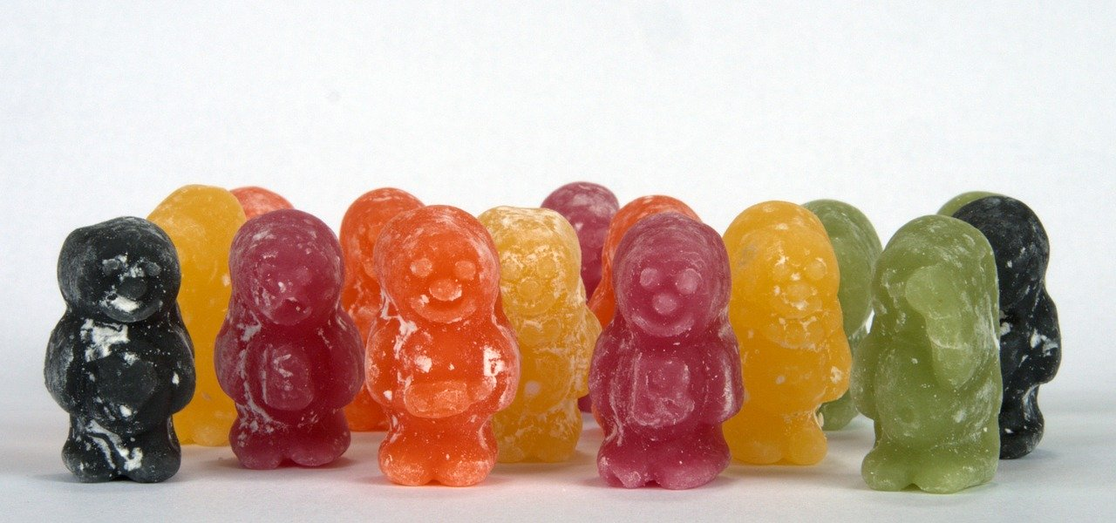
Safeguarding Basic Awareness
Who is responsible for safeguarding?
WE NEED AN
AWARENESS OF
THE ISSUES,
AND NEED TO
KNOW
HOW TO ACT IF
THERE ARE
CONCERNS
WE ALL PLAY
AN INTEGRAL
ROLE IN
DEVELOPING
HEALTHY
CHURCHES
!! SAFEGUARDING
IS
EVERYONE'S
RESPONSIBILITY !!
Part 2 - Safeguarding, Abuse and Grooming

Slide 15
Safeguarding Basic Awareness
The Parish Safeguarding Officer
Advise within the parish on all safeguarding matters.
Receive any concerns about children or adults.
Seek advice from the Diocese and/or statutory bodies.
Make referrals.
Undertaking parish safeguarding assessments.
Promoting safe practice.
Record keeping.
Part 2 - Safeguarding, Abuse and Grooming

Slide 16
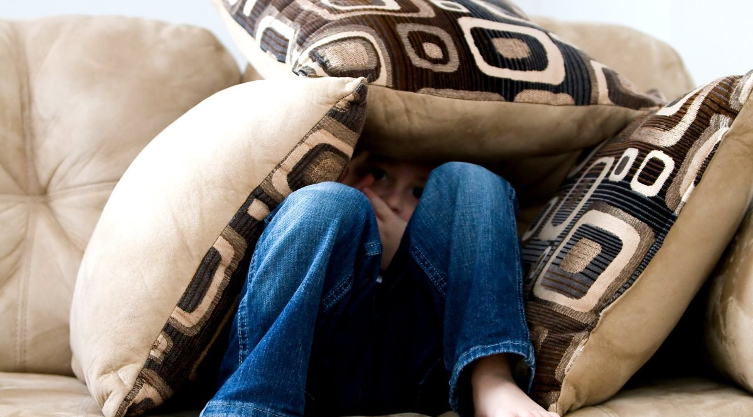
Safeguarding Basic Awareness
What is Abuse?
Consider the following two lists. Reflect for a moment on the key differences
between the paired items.
A heated argument......... | ..........Threatening behaviour
Healthy sexual activity......... | ..........Sexual assault
A 'strong' leader......... | ..........A domineering bully
Disciplining a child......... | ..........Emotional abuse
A legal power of attorney......... | ..........Financial abuse
Marital strife......... | ..........Domestic abuse
Part 2 - Safeguarding, Abuse and Grooming

Slide 17
Safeguarding Basic Awareness
What is Abuse?
Reflection
It is important to remember that most interactions between individuals in a Church context are completely safe, healthy, nurturing and enjoyable.
However, at times these close and trusting relationships could mean that we miss key signs and symptoms that suggest abuse may be occurring. Fundamentally, abuse is the misuse of power, a betrayal of trust, and harming those who are unable to protect themselves.
Church communities must be particularly vigilant to identify the warning signs and respond appropriately.
Part 2 - Safeguarding, Abuse and Grooming

Slide 18
Safeguarding Basic Awareness
Where does abuse happen?
Churches
Private Homes
Residential or day
care settings
School or Work
Hospitals
Online & in public
places
Part 2 - Safeguarding, Abuse and Grooming

Slide 19
Safeguarding Basic Awareness
How might I find out about abuse?
Someone tells you
what has happened or
you witness abuse directly.
Injury or behaviour consistent
with abuse or
intention to abuse.
Abuse is disclosed by
someone else who knows the
Person affected.
A disclosure regarding an
offender is made to you.
Indications of abuse are seen
in artwork, play or
creative writing.
Abusive posts or grooming
behaviour over the internet.
Anonymous sources
tell of abuse
Through accidents that happen
to a child or adult.
Suspicion is raised of
radicalisation or
human trafficking.
Part 2 - Safeguarding, Abuse and Grooming

Slide 20
Safeguarding Basic Awareness
What about confidentiality?
If someone is at risk of significant harm, or of harming others.
If a crime has been or may have been committed.
It is not a breach of confidentiality to seek advice and guidance from the Safeguarding Officer.
GDPR and the Data Protection Act 2018 are not barriers to justified information sharing.
When in doubt about the sharing of safeguarding information, please consult a Safeguarding Officer or equivalent in your setting.
Part 2 - Safeguarding, Abuse and Grooming

Slide 21
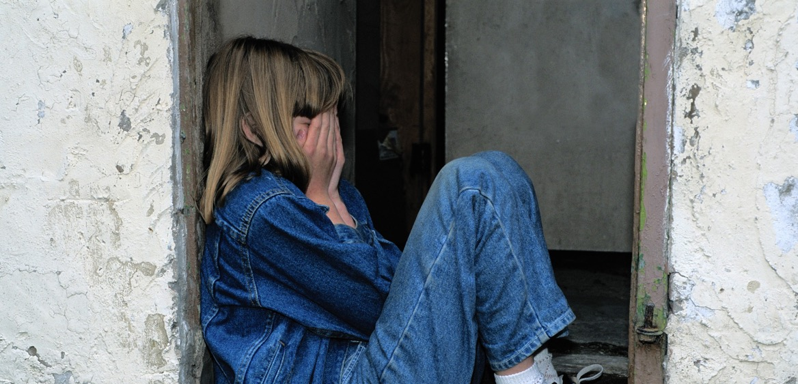
Safeguarding Basic Awareness
Forms of abuse
NEGLECT
DOMESTIC
ABUSE
PHYSICAL
ABUSE
SEXUAL
ABUSE
FINANCIAL
ABUSE
EMOTIONAL
ABUSE
SELF
NEGLECT
MODERN
SLAVERY
DISCRIMINATORY
ABUSE
ORGANISATIONAL
ABUSE
COERCIVE
CONTROL
SPIRITUAL
ABUSE
Part 2 - Safeguarding, Abuse and Grooming

Slide 22
Safeguarding Basic Awareness
Grooming
Offenders use:
Authority
Trust
Physical Force or
Threats
“Grooming is when someone builds an emotional connection with a child or adult to gain their trust for the purposes of committing abuse”
NSPCC
To gain:
Access
Control
In order to:
Abuse
From 'The Child Safeguarding Policy Guide for Churches and Ministries' (2017) by Basyle Tchividijian and Shira M. Berkovits.
Part 2 - Safeguarding, Abuse and Grooming

Slide 23
Safeguarding Basic Awareness
Review your learning - Part 2 (a)
Choose the correct definition of safeguarding from the list below:
A way for a church to avoid getting into trouble if a member of their congregation commits an offence.
Protection of rights to freedom and safety, promotion of wellbeing and collaboration with others to reduce risk of harm.
The regulations that statutory services enforce on churches.
Part 2 - Safeguarding, Abuse and Grooming

Slide 24
Safeguarding Basic Awareness
Review your learning - Part 2 (b)
Link these most common associated indicators of abuse with a specific category of abuse as outlined in Slide 21.
A failure to provide for basic physical needs including food, clothing, shelter, or social needs; failure to administer medication; isolating a person; failing to respect their privacy or independence.
Biting, kicking, punching, scalding.
Intimidation, coercion, harassment, use of threats, humiliation, bullying, or verbal abuse.
Indecent images taken; inappropriate touch without consent; indecent exposure; rape.
Part 2 - Safeguarding, Abuse and Grooming

Slide 25
Safeguarding Basic Awareness
Review your learning - Part 2 (c)
True or false?
Only young people and children can be subject to grooming.
Part 2 - Safeguarding, Abuse and Grooming

Slide 26
Safeguarding Basic Awareness
Review your learning - Part 2 (d)
Complete your review of Part 2 by selecting the correct statement from the list below:
You should always ask the individual affected for their permission to share a disclosure of abuse, unless you have agreed in advance to keep what they tell you a secret.
You should avoid sharing safeguarding information with friends and/or church members in case this results in fear / panic or causes rumours to spread.
It would be considered a breach in confidentiality to ask a safeguarding officer for advice about a situation without the person concerned giving their permission.
Part 2 - Safeguarding, Abuse and Grooming

Slide 27
Safeguarding Basic Awareness
Scenario 1 - Pastoral Visiting
78-year-old Margaret has attended your local parish church for many years. You are on the pastoral visiting team and you come to see her one morning. She explains that her son’s problem with alcohol has worsened, and he comes unannounced to her home and begs for money. She does not want to give it to him but she is afraid to say no. The last time she tried to refuse, he started yelling and screaming at her. He then threw a mug of hot coffee at her. Margaret says she would like things to change, but kept repeating “he is my only son”.
Question 1
Is this a concern?
Yes, She has indicated she would like things to change. She may be at risk of financial abuse as well as physical abuse.
No, Margaret is an adult and is able to look after herself.
Unsure, things may improve if her son seeks help for his alcohol problems.
Question 2
Who would you talk to about this situation?
I would try and speak to Margaret’s son and explain why his behaviour is disrespectful.
I would speak with neighbours as they may know more about the family situation and ways to assist Margaret.
I would speak to my parish safeguarding officer or equivalent for advice.
Part 3 - Safeguarding Scenarios

Slide 28
Safeguarding Basic Awareness
Scenario 2 - After school club
Oliver is a 9-year-old visually impaired child whose mother brings him to an after-school club on a Friday. He often looks very unkempt. Shortly after arrival he always immediately asks when a snack is being served. The helpers have also noticed that he takes extra food and puts it into his book-bag. He seems more withdrawn lately and does not play as he usually does with the other children. When you ask if everything is okay, he says “fine”.
Question 1
Is this a concern?
No. Oliver is a little under-confident, and his mother is bringing him to the club to help him socialise with other children.
Yes. Oliver exhibits behaviour that may indicate neglect.
Unsure. Maybe Oliver is simply struggling to fit in. I expect his mood will improve in time.
Question 2
Who would you talk to about this situation?
I would mention it to a friend whose opinion I respect, to see whether they can shed any light on this.
I would not mention this to anybody just yet, but would wait for more information.
I would mention this to a safeguarding officer.
Part 3 - Safeguarding Scenarios

Slide 29
Safeguarding Basic Awareness
Scenario 3 - Bellringers
John is a popular and experienced bell ringing teacher. He is well respected and known across the region. You have just heard from a young person who is one of his students that he is often unnecessarily close when teaching. He also asks the female students to send picture of themselves to him on their mobile phone for his own personal use.
Question 1
Is this a concern?
No. It is normal for adolescents to share and exchange photos on mobile devices, so their sharing these with John is not a problem.
Unsure. John is clearly great with students and this may all be harmless fun.
Yes. An adult leader of an activity should not be requesting images of young people for their personal use, or be inappropriately closer than expected during an activity.
Question 2
Who would you talk to about this situation?
I would talk to the girls and tell them to stop sending images, as they are ‘asking for trouble’.
I would not mention this to anybody jas it does not appear that anyone has been harmed, and it may damage John’s reputation.
I would ask my parish safeguarding officer or equivalent for further advice.
Part 3 - Safeguarding Scenarios

Slide 30
Safeguarding Basic Awareness
Scenario 4 - Head Server
Consider the following situation:
Part of the duties of the Head Server in a large church is to train boys and girls who wish to become junior servers. You are the parent of one of the children, and become aware that the Head Server is carrying out this task in the Vestry on an individual basis. The door to the Vestry, which is solid, is always closed during these sessions.
What is your concern?
The Head Server is grooming the children.
The Head Server is unaware of safe working practices.
Part 3 - Safeguarding Scenarios

Slide 31
Safeguarding Basic Awareness
Scenarios - Conclusions
!! If in doubt, report !!
Make a note of your observations.
Maintain a relationship with the affected person.
Report to the Safeguarding Officer.
Inform the church leader (Priest/Vicar/Minister).
Part 3 - Safeguarding Scenarios

Slide 32
Safeguarding Basic Awareness
Pause and reflect
Take the opportunity to have a break and digest the content of this courses far.
What has been the most significant aspect the course so far?
How have the issues raised challenged your faith?
Have they highlighted anything in particular in your own community?
Is there any action you need to take?
Part 3 - Safeguarding Scenarios

Slide 33
Safeguarding Basic Awareness
Why do we struggle to respond well?
FEAR
Ridicule, false accusations,’crying wolf’ or making a fuss.
Political correctness.
Convincing ourselves wait, Or that it is someone else’s job.
Responding well is not an easy thing to do…
Safeguarding involves dealing with uncertainty…
We are all vulnerable to these dynamics…
Part 4 - Responding Individually and Collectively

Slide 34
Safeguarding Basic Awareness
Safeguarding and healthy communities
“The core of safeguarding relies on an understanding and awareness of the dynamics between power and vulnerability in the relationships.”
Methodist Church in England and Wales,Past Cases Review 2015
Part 4 - Responding Individually and Collectively

Slide 35
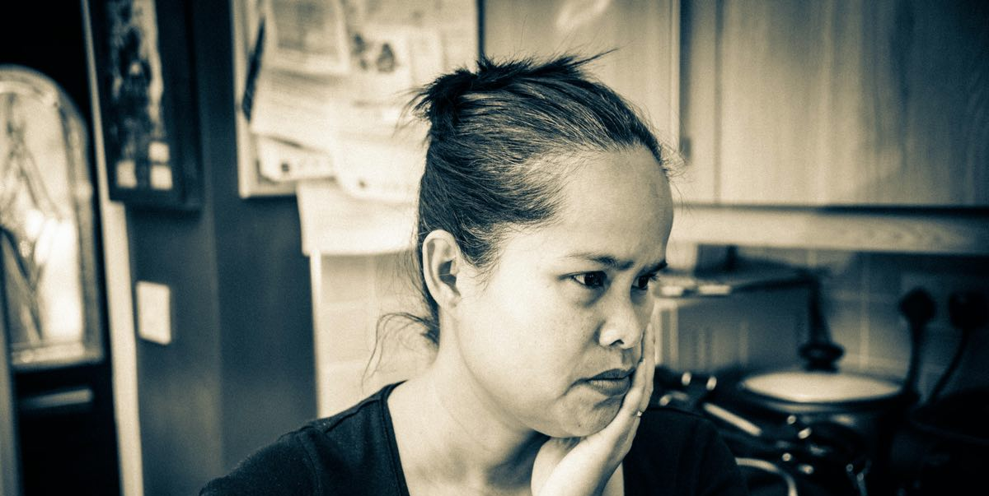
Safeguarding Basic Awareness
Safeguarding and forgiveness
In the cases of abuse in the church, a superficial understanding of forgiveness has been applied in the absence of other responses that promote accountability.
Forgiveness is NOT the opposite of justice
Biblical forgiveness does not silence victims
Victims need support and encouragement
Accountability is needed for perpetrators
Forgiveness does NOT remove the need to protect the vulnerable
Don't give opportunity for further abuse
Struggle with sin is real
Perpetrators of abuse are still a risk to others
Forgiveness is NOT the same as pretending bad things have not happened
The Gospel = grace and truth
Sin is forgiven, not hidden away
IS FORGIVENESS THE OPPOSITE OF JUSTICE?
FORGIVENESS INSTEAD OF PROTECTION?
FORGIVENESS = HIDING ABUSE?
Part 4 - Responding Individually and Collectively

Slide 36
Safeguarding Basic Awareness
How to respond to disclosure - the 4 R’s
Recognise —> Respond —> Record —> Refer
Recognise
Respond
Record
Refer
Accept and take seriously what is being said without displaying shock or disbelief.
Let the person tell their story and don’t push for information or ask leading questions.
Do not interrogate or decide if they are telling the truth.
Be alert to signs and symptoms of abuse.
Reassure the individual they have taken the right step in sharing this information and they are not to blame.
Be honest; never make promises to keep what you are being told confidential. If abuse is involved, you will need to tell someone.
Tell them what you will do with the information they have shared and that they will be kept informed.
Do not introduce personal information or from either your own experience or that of others.
Do not investigate the matter any further for yourself, or approach the person about whom allegations may have been made.
Write down, concisely, exactly what is seen, said or heard and make clear where you have added your views or interpretation.
You may find it helpful to use the 4 W’s, as follows:
WHO was involved? Name the key people
WHAT happened? Facts not opinions
WHEN did it happen? Date and time
WHO have you referred the issue on to?
Pass the information to the Safeguarding Lead or Diocesan Safeguarding Advisor in your setting within 24 hours
In case of an emergency call the Police or dial 999.
Part 4 - Responding Individually and Collectively

Slide 37
Safeguarding Basic Awareness
A note about self-care
Receiving information about someone else’s abuse can be very distressing for the listener for a number of reasons.
They can’t believe that this could happen to anyone.
It can’t possibly be true because the alleged perpetrator is such a nice person.
The disclosure may trigger similar personal and painful memories.
We need to recognise that it is normal to feel this way when listening to a disclosure of abuse, and to be able to access support for ourselves if and when we need it.
Part 4 - Responding Individually and Collectively

Slide 38
Safeguarding Basic Awareness
Final Assessment Scenario
This situation is shared with you by a close friend over coffee. You are both members of the same local parish church.
Your friend tells you that after last Sunday’s service, Jasmine approached her and asked to speak with her in a quiet place. She unexpectedly burst into tears and explained that over the last few months she has become overwhelmed by her caring responsibilities for her son. Her husband is frequently away on business trips and they have had marital problems.
She admitted that last week her husband hit Arthur on the leg because he would not go to sleep.
She said it was only once and that she knows her husband did not mean to hurt Arthur. She said she feels terrible about this because her son now has a small red bruise where her husband hit him.
Jasmine also mentioned that her husband frequently shouts at her and she is often unable to sleep.
Part 4 - Responding Individually and Collectively

Slide 39
Safeguarding Basic Awareness
Final assessment - question 1 of 10
Your friend asks you what you think about Jasmine and her husband. Which is the most appropriate response?
Gently state that it is not your place to judge the situation or those involved.
Change the topic of conversation and ignore your what your friend has said.
Give your opinion on them, no matter how negative.
Part 4 - Responding Individually and Collectively

Slide 40
Safeguarding Basic Awareness
Final assessment - question 2 of 10
What are the main risks in this situation and for whom are they a risk?
Becoming increasingly isolated and burdened by their caring responsibilities
Continued abuse and suffering
Being unfairly judged and treated like a criminal
Being viewed as a place that ignores or condones abuse if this situation is serious and comes to the attention of the public
Failing to advise your friend correctly
Part 4 - Responding Individually and Collectively

Slide 41
Safeguarding Basic Awareness
Final assessment - question 3 of 10
In terms of safeguarding, what are the concerns you have?
2. Match up the statements below with these these possible types of abuse and whether or not they are a current cause for concern.
(a) may be a cause for concern as Jasmine has reported being shouted at by her husband, and unable to sleep.
(b) is a cause for concern as Arthur has been deliberately hit on the leg.
(c) is not a cause for concern at present.
Neglect…
Physical abuse…
Psychological abuse …
Part 4 - Responding Individually and Collectively

Slide 42
Safeguarding Basic Awareness
Final assessment - question 4 of 10
What are the ideal outcomes for this situation?
Highlight all that apply:
Punishment for Jasmine’s husband and separation of him from the family. This is the most effective way to deal with such family problems.
That you and your friend involve the safeguarding officer as soon as possible.
Ensure the safety of Jasmine and Arthur to protect them from harm from potential abuse.
For the whole family to find security, support and stability through their connection to the church.
If the right support is in place, we should give an opportunity for repentance and reconciliation.
Part 4 - Responding Individually and Collectively

Slide 43
Safeguarding Basic Awareness
Final assessment - question 5 of 10
How might the actions selected on the previous page be brought about?
Think about how you could realistically respond and what would be best for everybody involved.
SELECT 2 from the responses below:
Deciding not to take this any further to avoid serious negative implications for Jasmine or her husband, and the alienation of their family from the church.
Reporting to the Safeguarding Officer, whose job it is to handle situations like this and who is in the best position to decide the best course of action.
Paying a visit to Jasmine and Arthur whilst the husband is home, and observing them in order to assess how serious this really is.
Ensuring that both Jasmine and Arthur are able to keep coming to church, and maintain ongoing contact with them.
Part 4 - Responding Individually and Collectively

Slide 44
Safeguarding Basic Awareness
Final assessment - question 6 of 10
Your friend also mentions that they have already spoken to the Children and Families Minister some months ago about a similar situation regarding Jasmine and Arthur. They advised your friend that Jasmine should forgive her husband and move on. They stated that there was nothing more to be done from their perspective and that we shouldn’t get involved in other people’s business.
What are your thoughts about this? (Select two):
We should submit to the authority of those whom God has appointed as leaders in the church, and their wider experience (eg Hebrews 13:17). Therefore, we should not take this matter any further.
I would consider going back with my friend to see the Children and Families minister in order to challenge their views and find an agreed way forward.
I would ask my friend if they kept a record of what led them to speak with the Children and Families Minister, as this could be helpful to show how long this may have been going on for.
Whilst I think forgiveness and reconciliation are good things, we also need to act to protect those who are suffering and prevent potential abuse from continuing (eg Psalm 12).
Part 4 - Responding Individually and Collectively

Slide 45
Safeguarding Basic Awareness
Final assessment - question 7 of 10
Your friend states that they don’t know what they should do next and asks you for advice.
Thinking carefully about all that’s been covered in this course, what would you advise them to do?
Select 2 from the following:
Your friend should be sure to find some hard evidence to back up the claims being made.
I advise my friend should maintain contact with Jasmine and support her as needed, but not actively investigate or ask leading questions.
I advise that they should not share this information with anyone else, but make a record of their conversation with Jasmine and speak with the safeguarding office as soon as possible.
As many people within the church leadership as soon as possible should be told as soon as possible so the incident isn’t dismissed.
Part 4 - Responding Individually and Collectively

Slide 46
Safeguarding Basic Awareness
Final assessment - question 8 of 10
Which step should you take next?
Think about the three different options below and select which one you think is the most appropriate:
I have no further part to play; I have advised my friend of what they need to do to take action, and this is where my responsibility ends.
What my friend has told me should be considered ‘safeguarding information’. I should make a written record of the conversation and refer this on to the safeguarding officer.
I should contact Jasmine to ensure she knows she isn’t alone, that I’m aware of her situation, and I want to help her find the best way forward.
Part 4 - Responding Individually and Collectively

Slide 47
Safeguarding Basic Awareness
Final assessment - question 9 of 10
When you are preparing your record for the safeguarding officer, in addition to printing your own name, adding your signature and the date of writing, what other 3 things would you include?
Time and date of conversation with my friend.
My thoughts on what should happen next.
My opinion / interpretation of the information.
Who else is aware of the situation, to the best of your knowledge.
An accurate description of what my friend said, including any exact wording.
Part 4 - Responding Individually and Collectively

Slide 48
Safeguarding Basic Awareness
Final assessment - question 10 of 10
In terms of timings, how quickly should you refer this on?
This is an emergency and must be dealt with immediately by calling 999.
This can wait until either my friend or I bump into the Safeguarding Officer at church next week.
Contact should be made with the Safeguarding Officer within the next 2-4 days to give my friends chance to try to remember more details and pass these on to me
Contact should be made with the Safeguarding Officer within 24 hours.
Part 4 - Responding Individually and Collectively

Slide 49
Safeguarding Basic Awareness
Take - aways
The Theological reflection is used on the Foundations module
Handout "Who's who in your setting?"
Handout “Theological
Reflection”
Part 4 - Responding Individually and Collectively

Slide 50
Safeguarding Basic Awareness
Summary and Conclusions
Awareness of and commitment to safeguarding
Connect the Christian faith and safeguarding
Recognise patterns of power and abuse
Identify the barriers to safeguarding
REMEMBER: SAFEGUARDING IS EVERYONES RESPONSIBILITY - We all have a role to play in the this “Gospel work”.
Apply a clear process to handling concerns
Part 4 - Responding Individually and Collectively

